Slide 1

Cortana Intelligence Workshop

Slide 2
Requirements
Windows system with Internet connection without troublesome corporate proxy (e.g. create a Windows virtual machine on Azure)
Azure Subscription (e.g. from MSDN or free trial)
Power BI Subscription (free tier is OK)
Local development tools
Download the Web Platform Installer from https://www.microsoft.com/web/downloads/platform.aspx. Run the Web Platform Installer. Install the following components:
Microsoft Azure PowerShell
Visual Studio Community 2015 with Microsoft Azure SDK – 2.9.6 (or later)
Download and install Data Factory Tools for Visual Studio 2015 at: https://marketplace.visualstudio.com/items?itemName=AzureDataFactory.MicrosoftAzureDataFactoryToolsforVisualStudio2015
Download and install Data Lake Tools for Visual Studio 2015 at: https://www.microsoft.com/en-us/download/details.aspx?id=49504 (select Microsoft.Azure.DataLakeToolsForVS2015.msi)
Optional – if you wish to run most of the steps automatically using PowerShell:
Install PowerShell Extensions for Microsoft SQL Server 2016: from https://www.microsoft.com/en-us/download/details.aspx?id=52676, download and install ENU\x64\PowerShellTools.msi

Slide 3
Requirements
Make sure you use a Windows machine. One step requires the use of a Visual Studio module that only works on Windows.
Do not use the Edge browser as there are compatibility issues with some Azure UIs. Internet Explorer 11, Chrome or Firefox will work.
Do not share an Azure Subscription with other lab participants. We will create some resources that cannot be shared

Slide 4
Part 1: Customer story

Slide 5
Background
Fabrikam is a manufacturer of compact cars selling in 60 countries. To compete in an increasingly commoditized market, Fabrikam would like build up customer engagement, especially in the young generations which value experiential brands.
Mark, the head of marketing, believes that the company lacks a detailed view of trending topics in social channels, as well as a informal way for customers to approach the company with complaints or inquiries.
Fabrikam car models
Wolverine
Polecat
Sea Otter
Sable

Slide 6
Background
Mark has seen videos about the Microsoft Bot Framework and the Cortana Intelligence Suite.
He’s asked for your support to run an experiment with user engagement bots.
He thinks it is very difficult to predict what kind of interactions the community will have with the bot. He would like to design the system openly, allowing users to formulate complaints or questions. He asks whether artificial intelligence can make the system better and better over time, as it learns from interactions users have with it.
Initially the bot should recognize very broadly what sort of message (e.g. inquiry about a specific model, or about open jobs), and direct the user to a specific page on the web site. Over time the bot should evolve to answer questions based on known information. Finally, if this test is successful, Mark envisions that a customer should be able to select, customize and even order a specific car.

Slide 7
Background
Customers who phone the call center are usually offered (after their request or issue is resolved) to receive a brochure by mail, or to make an appointment for a test drive in a garage. Call centers operators are provided with simple guidelines on what offer should be made for which type of customer.
Mark would like the bot to also make one of these offers to each customer that interacts with it. He thinks this offers significant potential in sales lead generation. However, he wonders whether the current rules really maximize the impact of this channel. For example, customers who call to complain are not normally offered an appointment for a test drive, although they might actually be passionate about the brand.
Mark asks you whether machine learning can help deciding which offer to extend to which customer interacting with the bot.

Slide 8
Background
Mark periodically checks web analytics data. He just saw that a week ago, there was a sudden spike for web searches for «Fabrikam airbags» following an incident where a popular singer was killed by a faulty airbag in a car from another manufacturer. Mark thinks that if he had known this at the time, he would have actively promoted the quality and safety record of the Fabrikam airbags.
Mark expects that the bot channel will allow Fabrikam to capture such trends in real-time. However, he is concerned that it might be complex to find topics in unstructured textual data.
Mark would like to have a dashboard on his mobile phone showing trending topics over the past few days, as well as general sentiment expressed in messages in the bot channel. Sentiment should be in near-real-time and alerts should be generated if a threshold is crossed. This will allow him to react quickly in case of a major event.

Slide 9
Customer questions
I’d like my customers to be able to interact with the bot on our website, but also in Skype and other messaging apps. What does that require in additional development?

Slide 10













Solution Logical Architecture
HOT PATH
LUIS
Cognitive Service
Bot
Logic App
Event Hub
Stream Analytics
Power BI
Select best offer
Sentiment analysis
Key phrase extraction
COLD PATH
Azure ML Web Service
Text Analytics Cognitive Service
Data Lake Analytics
Data Lake Store
SQL Data Warehouse
Operationalize model
Orchestration
Azure ML
Azure Storage
Data Factory

Slide 11
Phased deployment
The solution uses machine learning in multiple places. Cognitive services for sentiment analysis and key phrase extraction require no training and can be used off-the-shelf. However, the language understanding model (LUIS) and offer acceptance prediction model (Azure ML) require labeled data to be collected before they can be deployed.

Slide 12
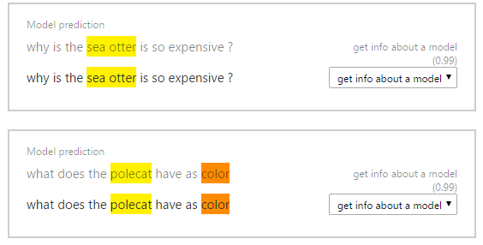
Phased deployment
We will first run the bot with an empty a language understanding model. We will then manually label the utterances collected from the “real world”, so that the understanding model is able to extract and label intents concepts, such as complaining about a particular car model.

Slide 13
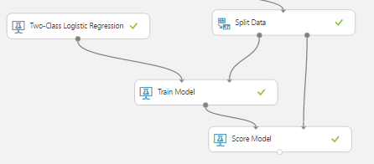
Phased deployment
We will initially build the system without Azure machine learning. The bot will randomly make an offer (brochure or appointment) to each bot user. After a language understanding model is deployed, we will be able to collect structured data to train our model.
We will then create a machine learning model to predict which offer is most likely to be accepted based on the message sent by a bot user. We will then modify the bot to use this machine learning model to make targeted offers.
Finally we will extract trending topics and set-up interactive dashboards to allow deep insights, as well as real-time alerting to allow reacting to surges in negative sentiment.

Slide 14


Phase 1: collect and label utterances
User: What’s the max speed of the Polecat?
Intent: get datasheet information
Bot: <canned answer>
What’s the max speed of the Polecat?
Entity: attribute
Entity: model
Label unknown utterances (http://luis.ai)
Fabrikam analyst

Slide 15
Phases 2 and 3: train and deploy machine learning
Phase 2: Issue a random offer to users, and capture their response
User: What’s the fuel efficiency of the Sable?
Bot: here’s where you can find the datasheet of the Sable
Intent: get datasheet information
Entity: model “Sable”
Entity: attribute “fuel efficiency”
Bot: <random offer>
Build and train a machine learning model
Offer: brochure
Result: accepted
User: <accept or reject the offer>
Phase 3: Instead of a random offer, issue offer most likely to be accepted

Slide 16
Phase 4: cold path processing & analytics
Real-time processing
HOT PATH
Power BI
Key phrase extraction
COLD PATH
Cognitive services (embedded in ADLA)
Data Lake Analytics
Data Lake Store
SQL Data Warehouse
Orchestration
Data Factory

Slide 17
Solution architecture notes
In a real project, a more streamlined solution might be proposed. For example, the Azure extensions for Bot Builder provide a module to write all messages to Azure Tables. However, in this workshop, we introduce Logic Apps and Azure Functions, as they can be used flexibly for rich integration scenarios.
In a real project, we would not always present the user with the offer that’s predicted to be the «best» for that case. In a small, randomly selected fraction of the cases, we would issue a random offer. This allows us to collect data to retrain our models in the future.
For the first version of a bot, it would make sense to start with a Q&A bot, by using the QnA Maker and existing FAQ information.

Slide 18
Part 2: Lab

Slide 19
Instructions
The hackathon can be run in two modes:
Manually on the Azure Portal
Follow the instructions in the following pages.
This is recommended if you are relatively new to Azure or Cortana Intelligence Suite.
Using PowerShell to run most of the steps automatically (such as creation and configuration of resources). Some steps are manual, the scripts will guide you with the necessary steps.

Slide 20
Instructions
RDP into Bot Builder Workstation
Username: labuser
Password: B0tFram3w0rk!
Start Visual Studio 2015. Click Sign in, using your Azure subscription credentials. It takes a few minutes to start VS2015 for the first time.
Run Windows PowerShell as administrator. Don’t use PowerShell ISE.
CD to C:\Repos\next-best-offer-bot\Config folder
Run “notepad config.ps1”
Change the value of the variable $studentnumber to a two-digit number assigned to you.
Save and close config.ps1
Run Login-AzureRmAccount to sign in to your Azure subscription.
If you have more than one Azure subscriptions, run Get-AzureRmSubscription and then run Select-AzureRmSubscription, providing either SubscriptionName or SubscriptionId
Change directory to the C:\Repos\next-best-offer-bot\Scripts folder, which contains all the PowerShell scripts to automatically create resources for this lab.

Slide 21
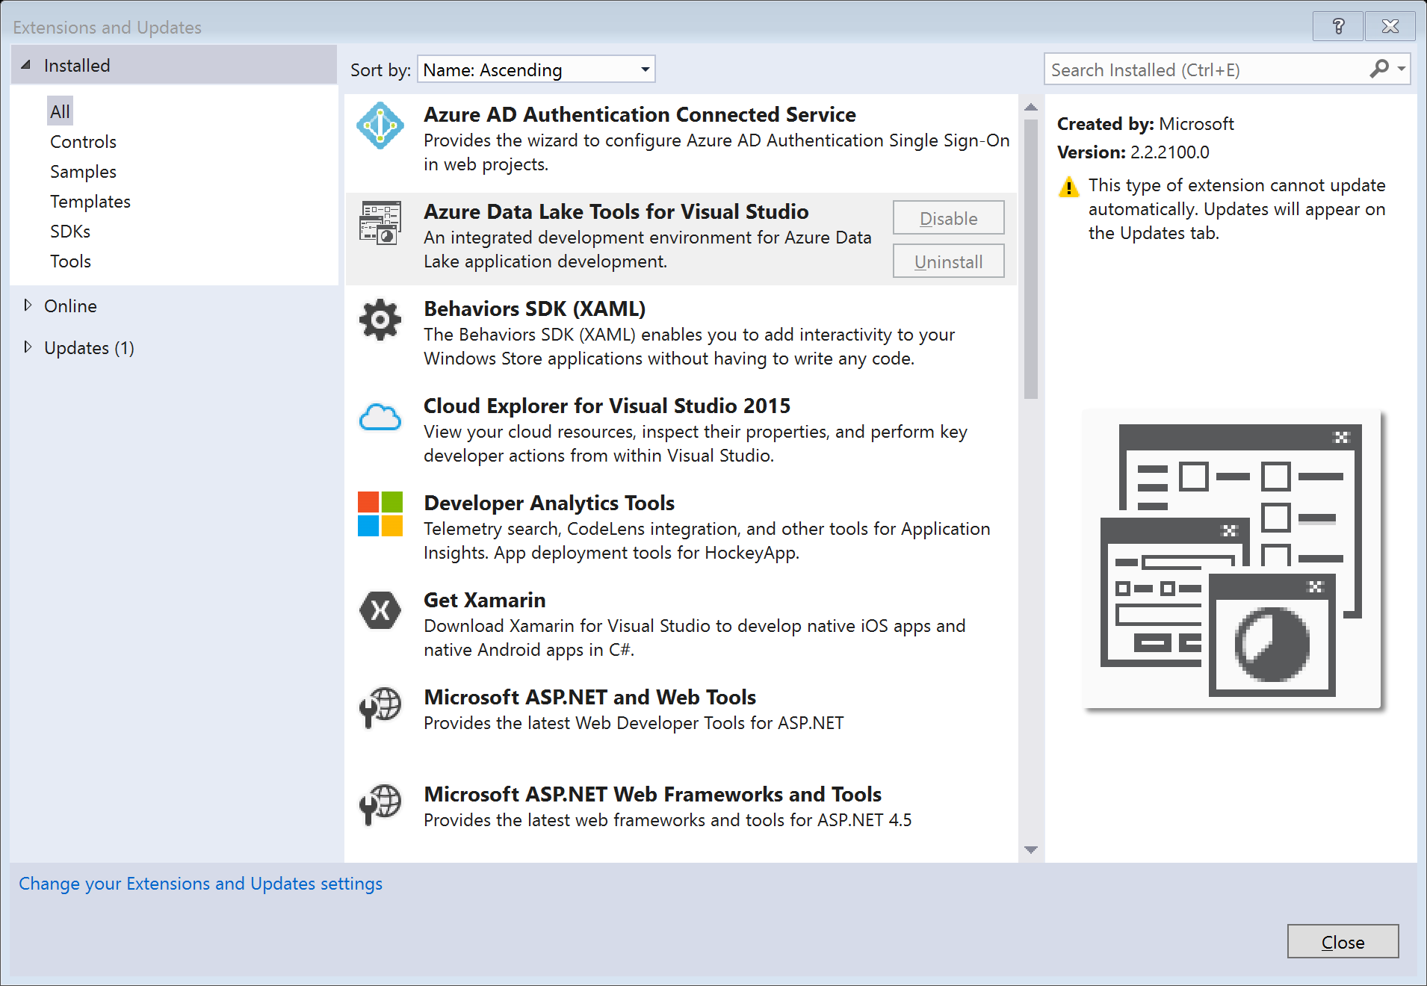
Verify module installation
In Visual Studio 2015, go to menu Tools → Extensions and Updates
Under Installed → All:
Check that Azure Data Lake Tools for Visual Studio is present in the list.
Click Azure Data Lake Tools for Visual Studio
Check that the version is at least 2.2.2100.0.

Slide 22
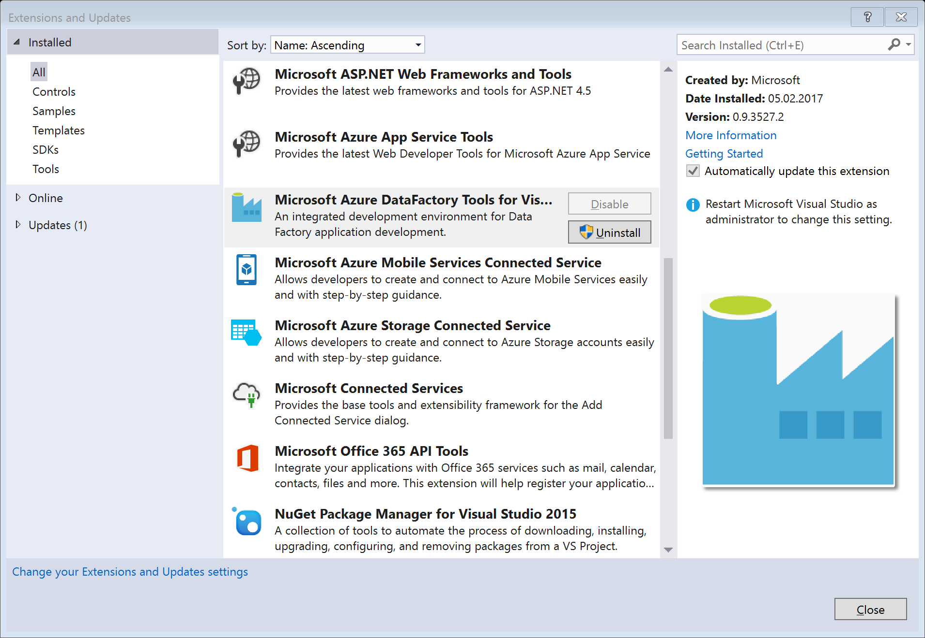
Verify module installation
Under Installed → All:
Check that Azure Data Factory Tools for Visual Studio is present in the list.
Click Azure Data Lake Tools for Visual Studio
Check that the version is at least 0.9.3527.2.

Slide 23
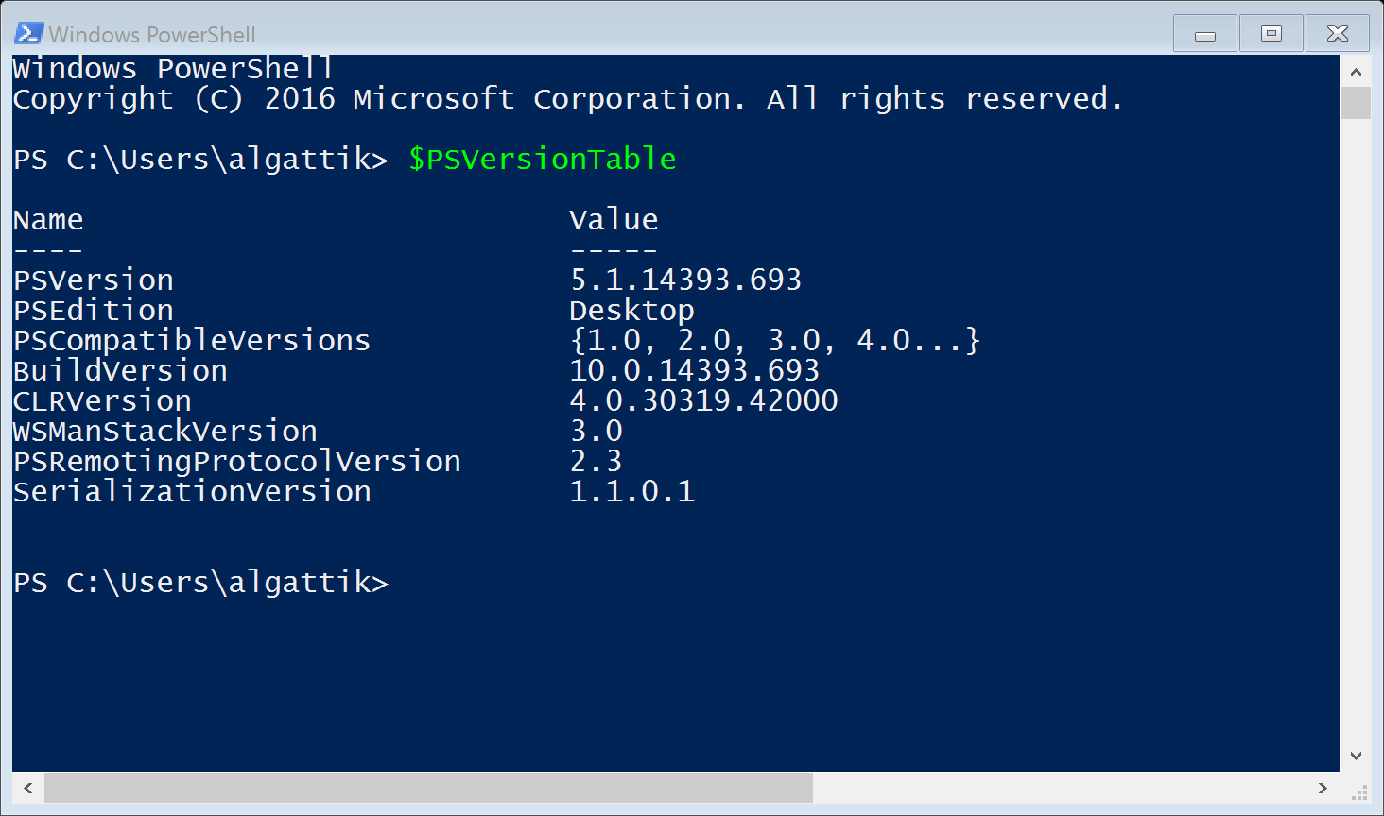
Verify module installation
From the Start menu, open Windows PowerShell
Type $PSVersionTable
Press Enter
Check that PSVersion is at least 5.0

Slide 24
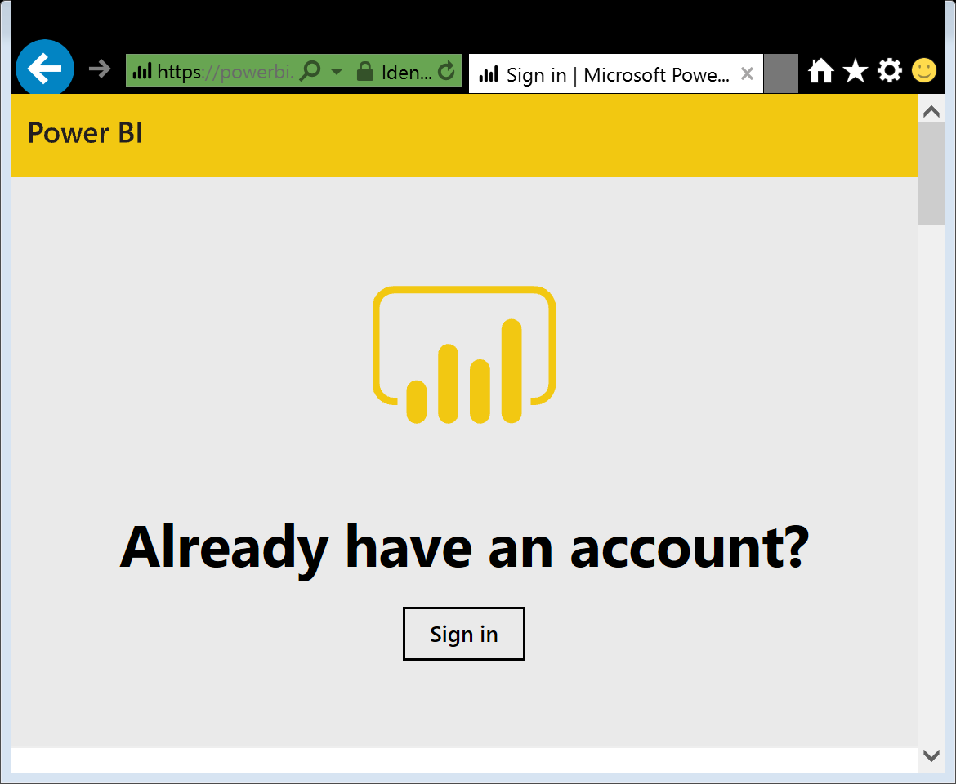
Verify Power BI access
Navigate to https://app.powerbi.com/
Sign in with your corporate credentials
Check that your sign-in is successful
NB: it is fine to use a personal account (for example linked to an Azure Pass) for creating Azure resources for the lab, and a corporate account for Power BI.

Slide 25
Phase 1: Collect and label utterances

Slide 26
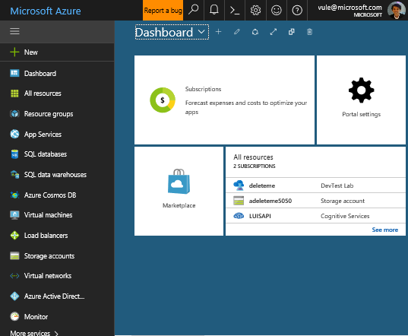
Log into Azure portal
Navigate to https://portal.azure.com
If needed, log in with your Azure credentials

Slide 27
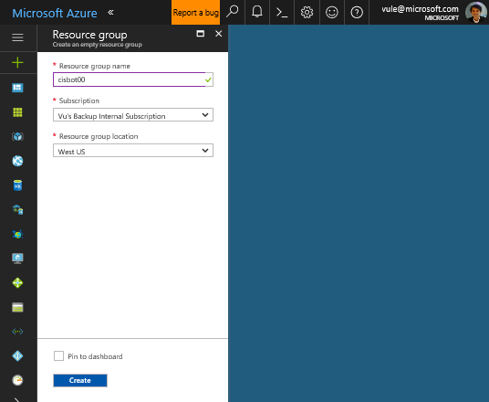
Create a resource group 110-create-resource-group.ps1
Create a resource group as a holder for the various resources we will create in this hackathon. We will create all resources in this resource group.
Go to Resource groups → Add
Enter name (cisbot[nn] where [nn] is your student number)
Select West US for location
Click Create

Slide 28
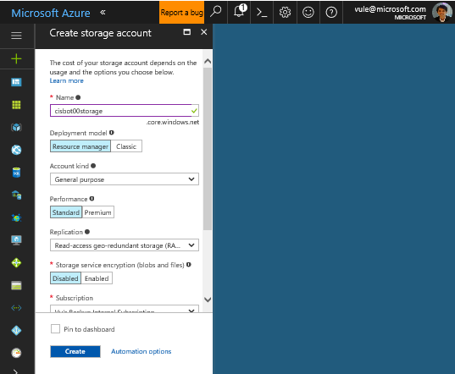
Create a storage account (1/4) 120-create-storage.ps1
Create a storage account to store various datasets and scripts as blobs.
Go to New → Storage → Storage account
Enter a unique name (cisbot[nn]storage)
Leave other parameters to their default value
Select the existing resource group cisbot[nn]
Use West US for location
Click Create

Slide 29
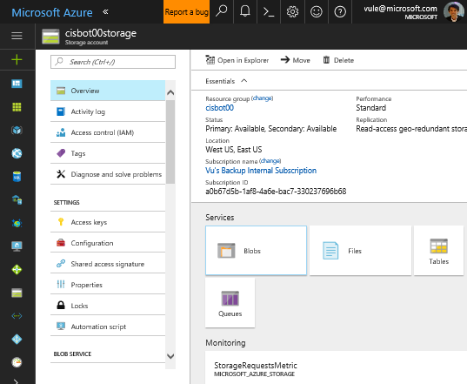
Create a storage account (2/4) 120-create-storage.ps1
Wait for storage account creation to complete. Navigate to your newly created Storage account
Click Blobs

Slide 30
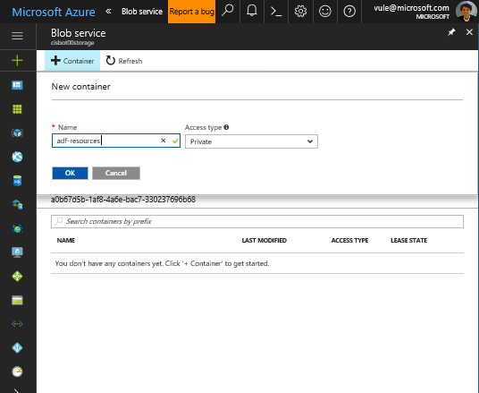
Create a storage account (3/4) 120-create-storage.ps1
Click + Container
Enter name (adf-resources)
Leave Access type to Private
Click OK

Slide 31
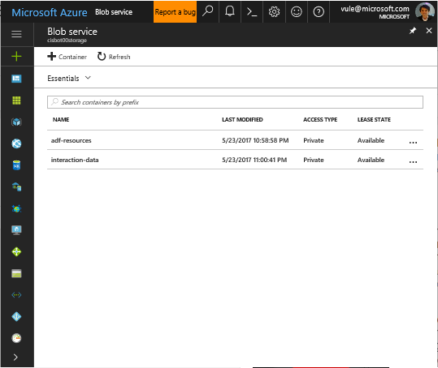
Create a storage account (4/4) 120-create-storage.ps1
Create a second container with the name interaction-data

Slide 32
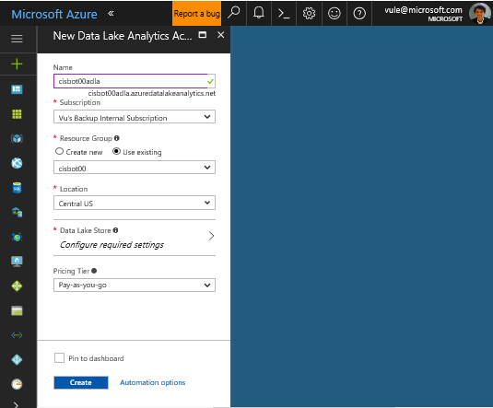
Create a Data Lake (1/2) 130-create-data-lake.ps1
Create a Data Lake Analytics account to run U-SQL jobs. This will also create a Data Lake Store.
Go to New → Data + Analytics → Data Lake Analytics
Enter a unique name (cisbot[nn]adla)
Select existing resource group cisbot[nn]
Choose Central US for location

Slide 33
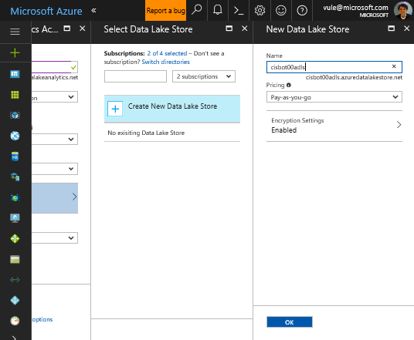
Create a Data Lake (2/2) 130-create-data-lake.ps1
Click on Data Lake Store section
Click on Create New Data Lake Store
Enter a unique name (cisbot[nn]adls)
Click OK
Click Create

Slide 34
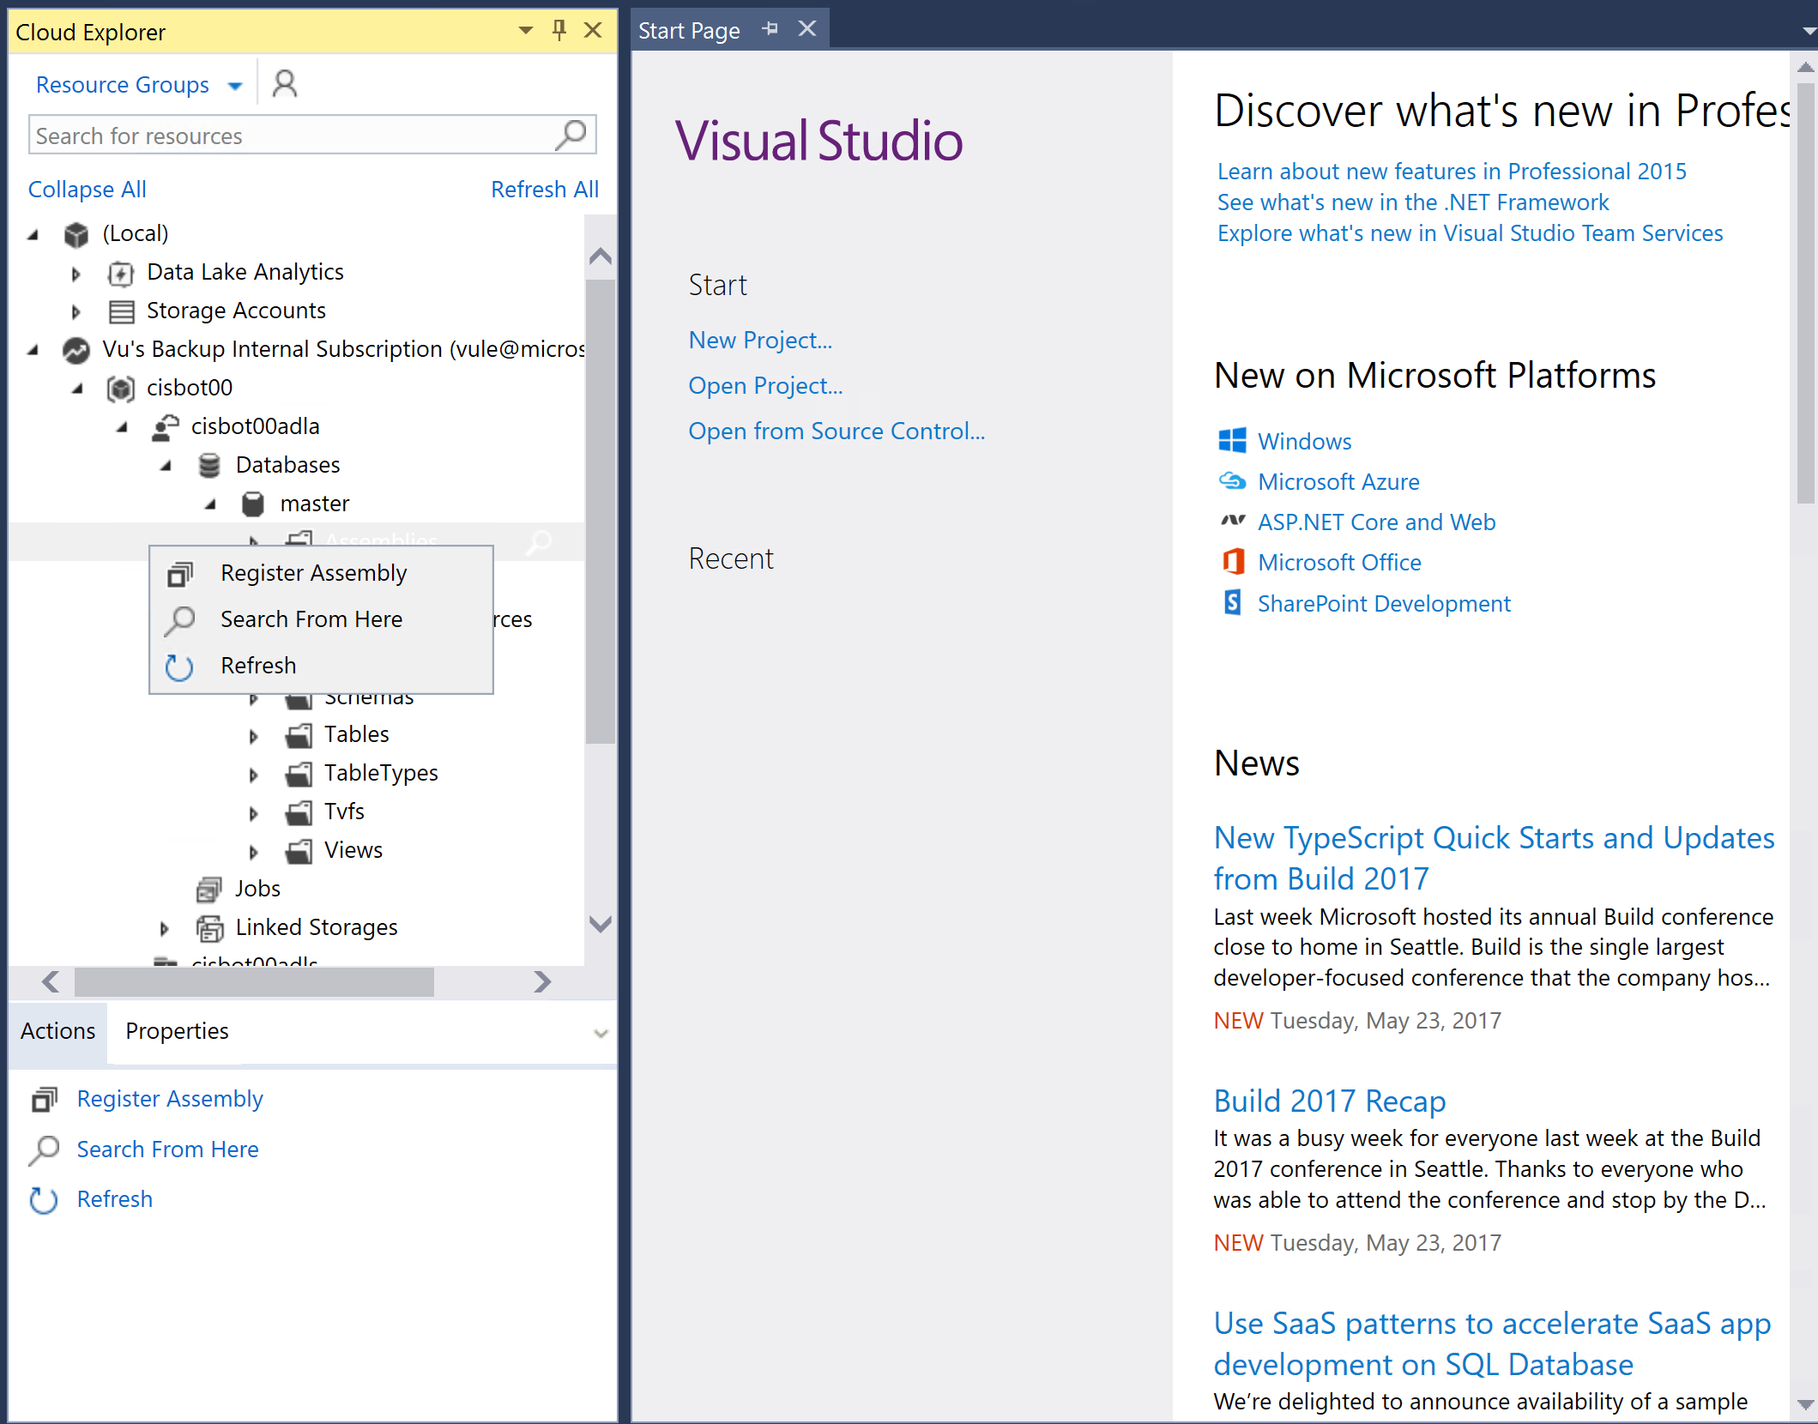
Add JSON library to Data Lake (1/3) 130-create-data-lake.ps1
Data Lake Analytics comes with an XML parser, but parsing JSON requires a custom extension. We’ll add it to our account.
In Visual Studio 2015, go to View → Cloud Explorer
Enter the credentials for your Azure account if needed
Under your Data Lake Analytics account → Databases → master, Right-click Assemblies, then click Register Assembly
Note: If you get an error message about Data Lake Tools. Restarting VS2015 should fix it.

Slide 35
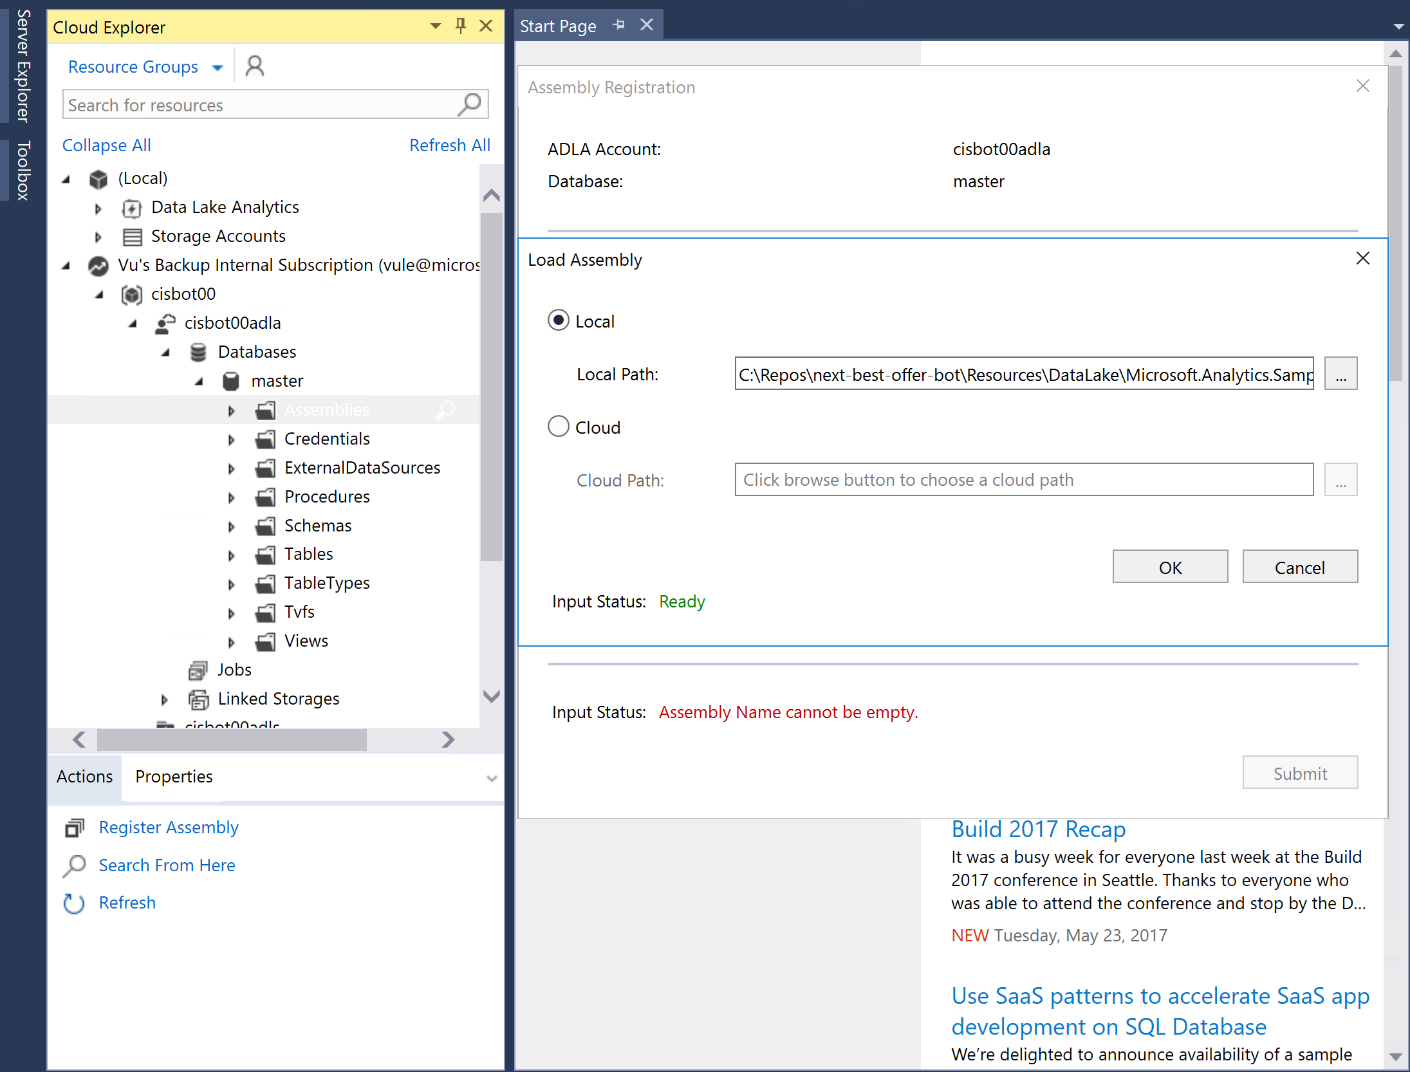
Add JSON library to Data Lake (2/3) 130-create-data-lake.ps1
Click on the “Choose assembly path” ellipsis
To the right of Local Path, select:
C:\Repos\next-best-offer-bot\Resources\DataLake\Microsoft.Analytics.Samples.Formats \Microsoft.Analytics.Samples.Formats.dll
Click OK

Slide 36
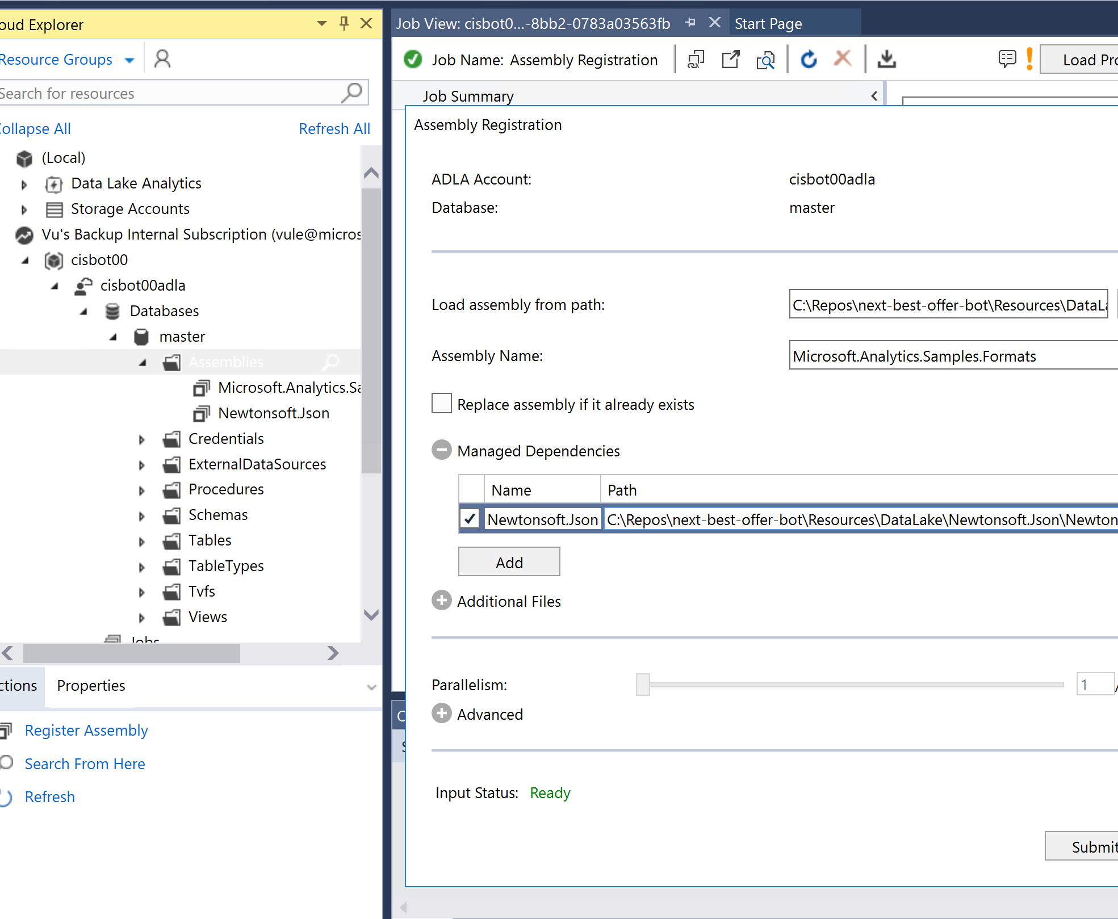
Add JSON library to Data Lake (3/3) 130-create-data-lake.ps1
Expand Managed Dependencies
Click the checkbox next to Newtonsoft.Json
Paste this path: C:\Repos\next-best-offer-bot\Resources\DataLake\Newtonsoft.Json\Newtonsoft.Json.dll
Click Submit. If prompted to select a Path, click Yes to accept the default proposal.
Wait for the job to complete preparing, queued, executing, and finalized stages.

Slide 37
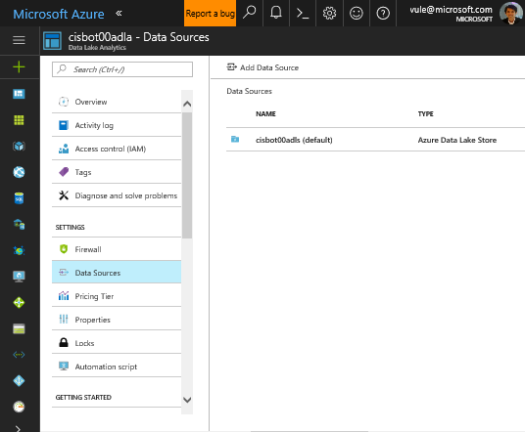
Connect Blob storage to Data Lake Analytics (1/2) 130-create-data-lake.ps1
Azure ML can’t connect directly to Data Lake Store (yet), so we will have our Data Lake job write out data for Azure ML to Blob storage. This requires connecting our Data Lake Analytics account to our storage account.
In Azure Portal, navigate to your Data Lake Analytics Account
Under your Data Lake Analytics account, select SETTINGS → Data Sources, then Add Data Source

Slide 38
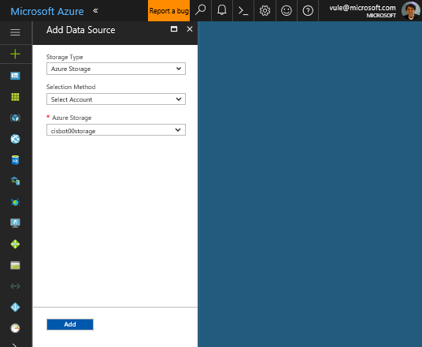
Connect Blob storage to Data Lake Analytics (2/2) 130-create-data-lake.ps1
Select Azure Storage for Storage Type
Under Azure Storage, select the storage account you created previously (cisbot[nn]storage)
Click Add

Slide 39
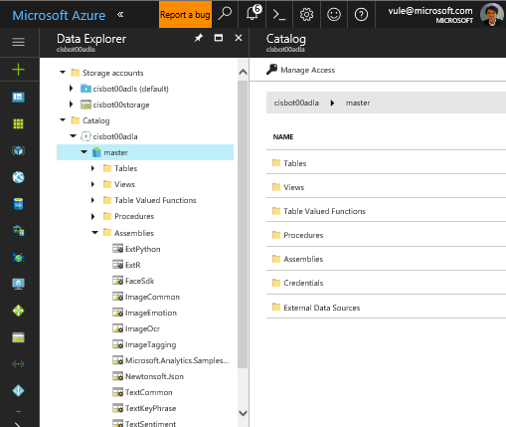
Add advanced extensions to Data Lake
Install cognitive extensions for text analytics
In your Data Lake Analytics account, browse to GETTING STARTED → Sample Scripts
Click the “USQL Advanced Analytic…” to install the advanced extensions for text analytics
Make sure the job to register extension assemblies finished successfully.
Navigate to your Data Lake Analytics > Overview > Data Explorer > Expand Catalog node to ensure all assemblies are registered as in screenshot.

Slide 40
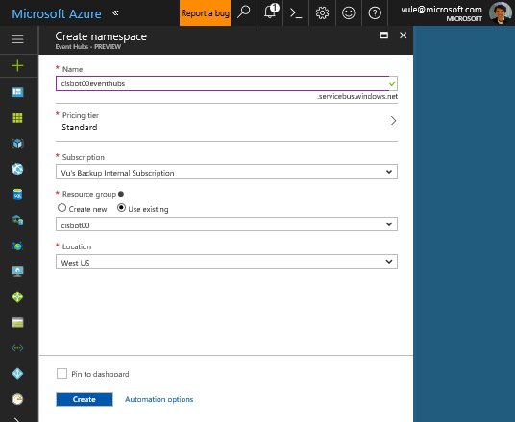
Create Event Hub (1/5) 140-create-event-hub.ps1
Create an Event Hub – the component for ingestion and transient storage of events for consumption by Stream Analytics.
In Azure Portal, go to New → Internet of Things→ Event Hubs
Enter a unique name (cisbot[nn]eventhubs)
Leave Pricing tier as Standard
Select existing resource group cisbot[nn]
Click Create

Slide 41
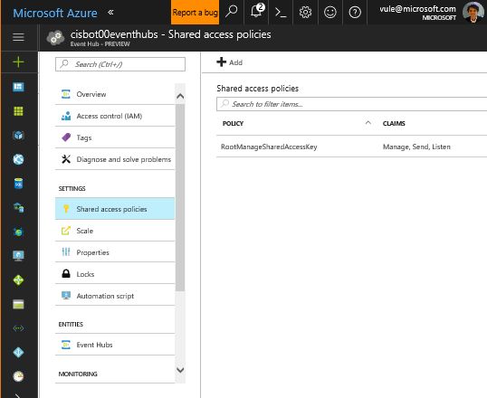
Create Event Hub (2/5) 140-create-event-hub.ps1
Navigate to your newly created Event Hubs namespace
Click SETTINGS → Shared access policies
Click + Add

Slide 42

Create Event Hub (3/5) 140-create-event-hub.ps1
Enter name sendFromBot
Check the Send Claim
Click Create

Slide 43

Create Event Hub (4/5) 140-create-event-hub.ps1
Add another policy with name listenIntoStreamAnalytics
Check the Listen Claim
Click Create

Slide 44
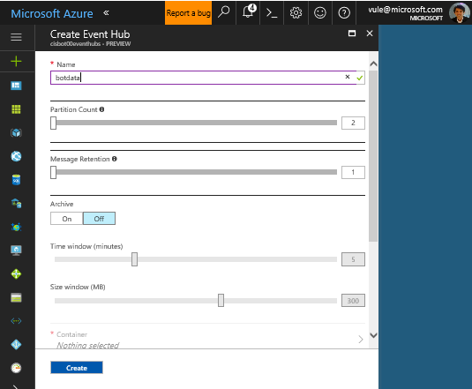
Create Event Hub (5/5) 140-create-event-hub.ps1
Navigate to ENTITIES → Event Hubs
Click + Event Hub
Enter name botdata
Click Create

Slide 45
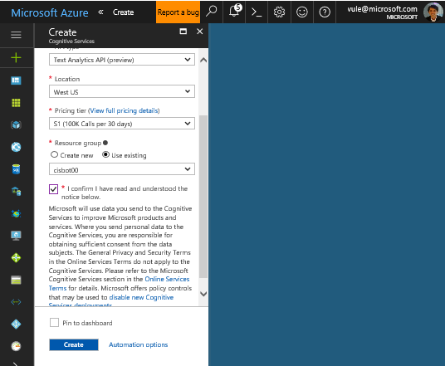
Create Logic App (1/10) 160-create-logic-app.ps1
Create Text Analytics Cognitive Service to be used for sentiment analysis.
Go to New → Data + Analytics → Cognitive Services
Enter a name (cisbot[nn]textanalytics)
Select API type: Text Analytics API
Select S1 Pricing tier
Select your existing resource group (cisbot[nn])
Agree to the terms
Click Create

Slide 46
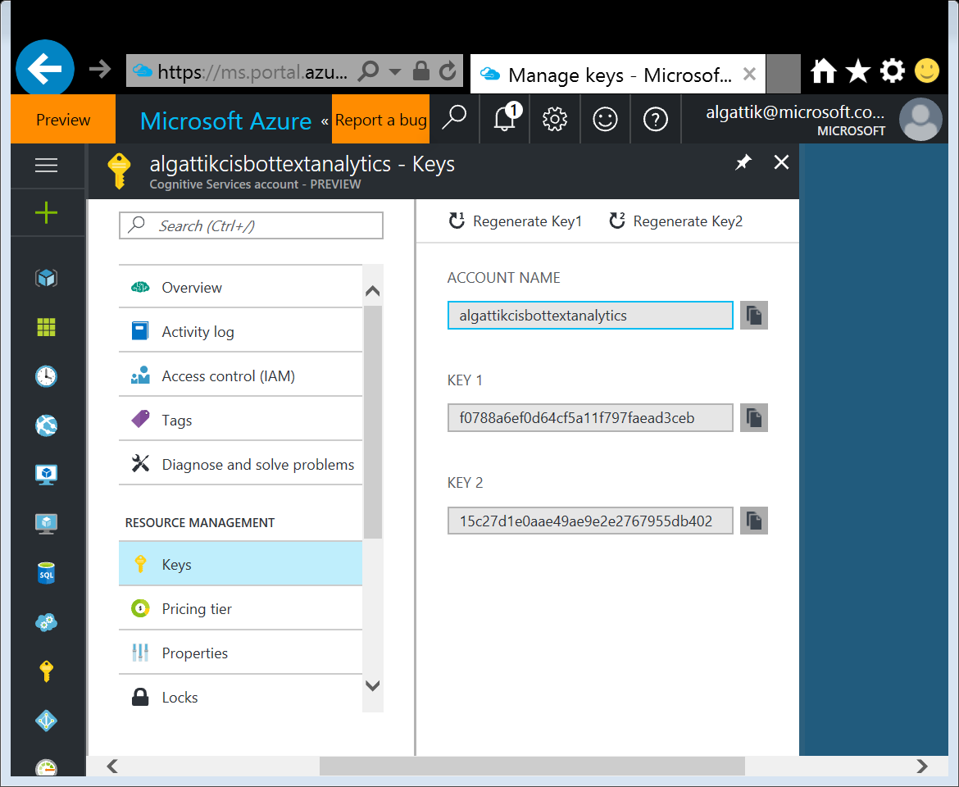
Create Logic App (2/10)
Copy Text Analytics service key
Navigate to your recently created Text Analytics account
Click RESOURCE MANAGEMENT → Keys
Copy Key 1 to some temporary location. You’ll need it within the next few steps.

Slide 47
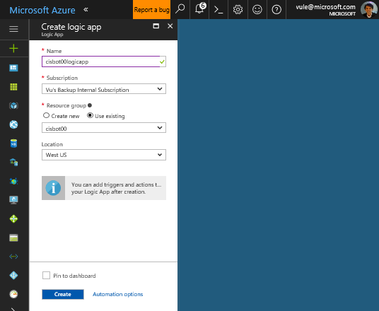
Create Logic App (3/10) 160-create-logic-app.ps1
Create a Logic App, i.e. an integration workflow that will run text analytics on bot messages and forward them to event hub.
Go to New → Enterprise Integration → Logic App
Enter a name (cisbot[nn]logicapp)
Select your existing Resource group
Click Create

Slide 48
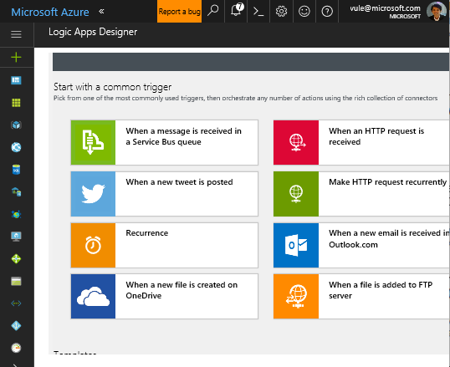
Create Logic App (4/10) 160-create-logic-app.ps1
Select Logic App trigger
Navigate to your recently created Logic App
The portal will automatically open up the Logic Apps Designer. If not, click Edit
Scroll down and select When an HTTP request is received

Slide 49
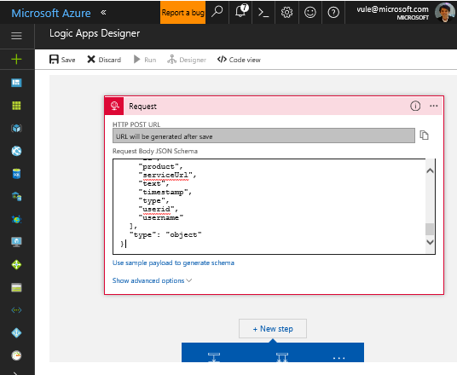
Create Logic App (5/10) 160-create-logic-app.ps1
Specify request JSON schema
Open the file C:\Repos\next-best-offer-bot\Resources\LogicApp \request-schema.json and copy the content of the file into the clipboard
In the Logic Apps Designer, click on the Edit link at the bottom of the Request trigger
Paste the clipboard into the Request Body JSON Schema field

Slide 50
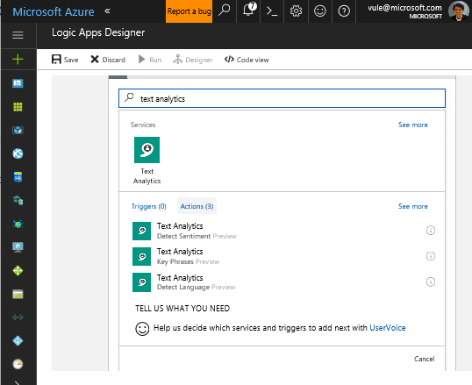
Create Logic App (6/10)
Create new Logic App Action to do sentiment detection
Scroll down a bit and click New step → Add an action
In the search box, type text analytics
From the result list, select Text Analytics – Detect Sentiment

Slide 51
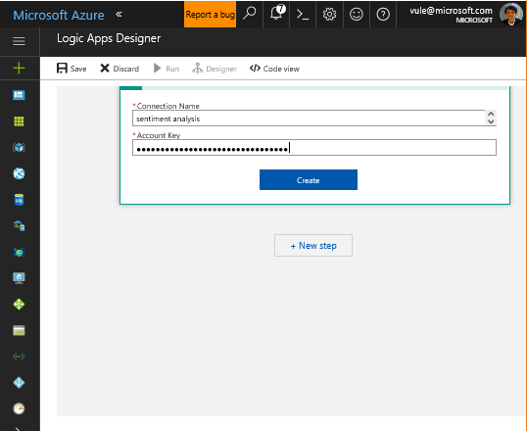
Create Logic App (7/10)
Create Text Analytics API Connection
Enter a descriptive text in the Connection Name textbox (sentiment analysis)
Enter the key of the Text Analytics account you copied earlier
Click Create

Slide 52
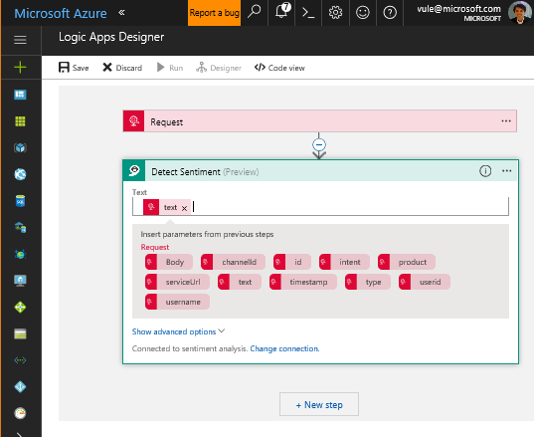
Create Logic App (8/10)
As input for the Detect Sentiment action, select the text field, then click on the text parameter from the previous step

Slide 53
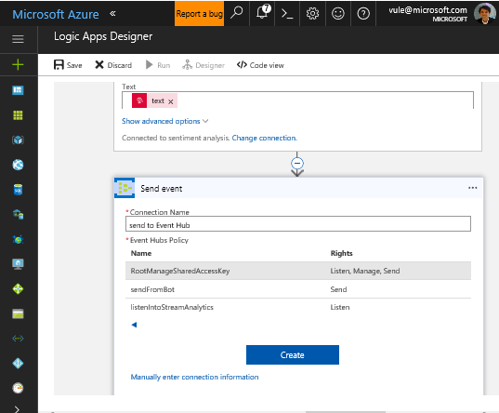
Create Logic App (9/10)
Create new Logic App Action and API Connection to Event Hub
Click New step → Add an action
In the search box, type event hubs
From the result list, select Event Hubs – Send event
Enter a descriptive text in the Connection Name (send to Event Hub)
Under Event Hubs Namespace, choose the event hub created earlier.
Select RootManageSharedAccessKey access policy
Click Create

Slide 54
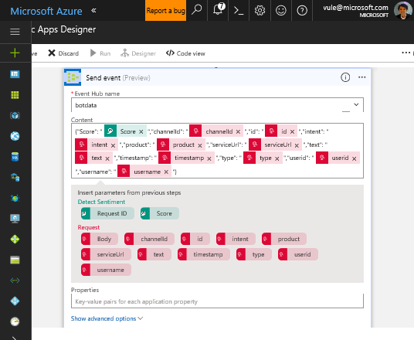
Create Logic App (10/10)
Select Event Hub name (botdata)
Copy the following JSON to the Content field. Fill the values with dynamic content placeholders.
Click Save
{
"Score": "",
"channelId": "",
"id": "",
"intent": "",
"product": "",
"serviceUrl": "",
"text": "",
"timestamp": "",
"type": "",
"userid": "",
"username": ""
}

Slide 55
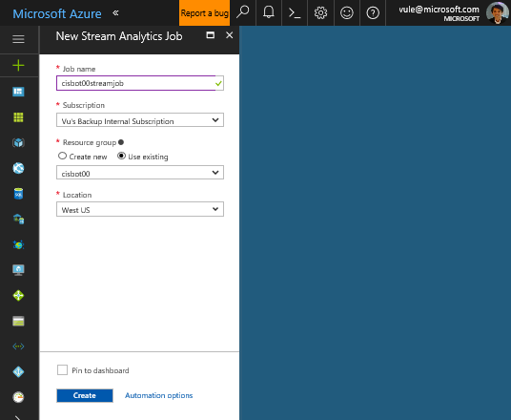
Create Stream Analytics (1/6) 170-create-stream-analytics.ps1
Create a Stream Analytics job that pulls bot messages from the Event Hub and store them in the Data Lake Store. In addition, it computes average sentiment over a time window and forwards that data to Power BI for real-time dashboarding.
Go to New → Internet of Things → Stream Analytics Job
Enter a name (cisbot[nn]streamjob)
Select your existing resource group
Click Create

Slide 56
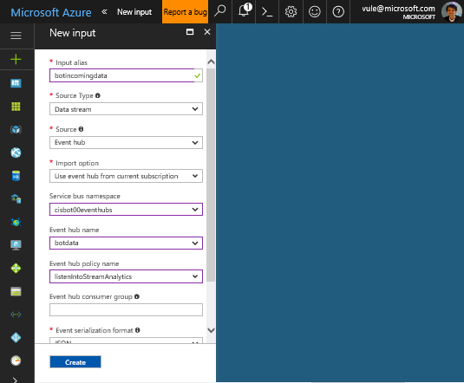
Create Stream Analytics (2/6) 170-create-stream-analytics.ps1
Navigate to your newly created Stream Analytics Job
Click JOB TOPOLOGY → Inputs, then + Add
As Input alias, enter botincomingdata
Select your event hub namespace, name, and listen policy
Click Create

Slide 57
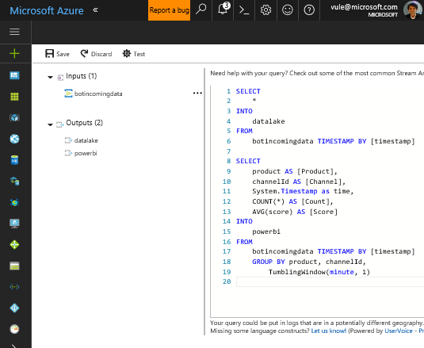
Create Stream Analytics (3/6) 170-create-stream-analytics.ps1
Click JOB TOPOLOGY → Query
Copy the following query and paste it in the query textbox
SELECT
*
INTO
datalake
FROM
botincomingdata TIMESTAMP BY [timestamp]
SELECT
product AS [Product],
channelId AS [Channel],
System.Timestamp as time,
COUNT(*) AS [Count],
AVG(score) AS [Score]
INTO
powerbi
FROM
botincomingdata TIMESTAMP BY [timestamp]
GROUP BY product, channelId,
TumblingWindow(minute, 1)
Click Save and confirm if asked

Slide 58
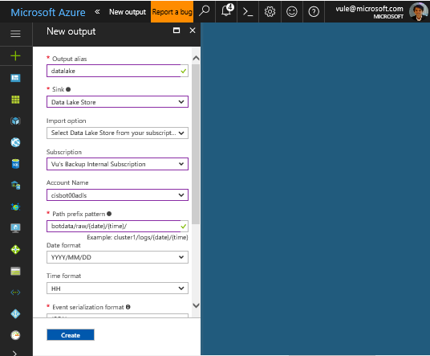
Create Stream Analytics (4/6)
Click JOB TOPOLOGY → Outputs, then + Add
As Output alias, enter datalake
For Sink, select Data Lake Store
Click Authorize
Select subscription and Data Lake Store account
In the Path prefix pattern textbox, enter botdata/raw/{date}/{time}/
Click Create

Slide 59
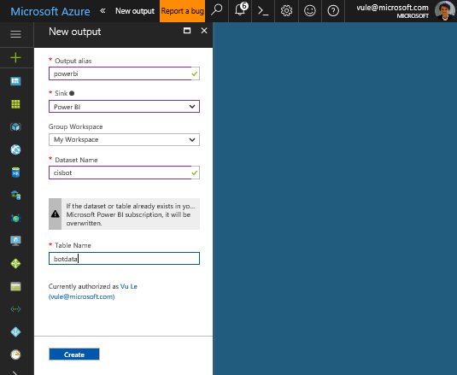
Create Stream Analytics (5/6)
Add another output by click on +Add
For Output alias, enter powerbi
For Sink, select Power BI
Click Authorize and log in with your Power BI account. Need to provide sample PBI account for those who don’t have their own.
As Dataset Name, enter cisbot
As Table Name, enter botdata
Click Create

Slide 60
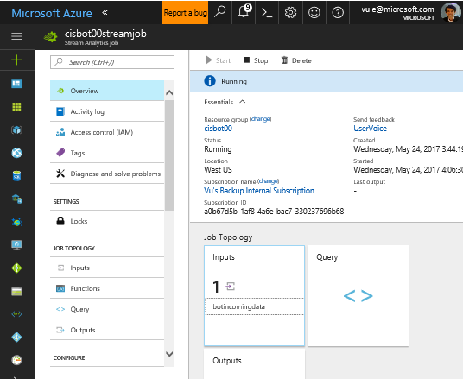
Create Stream Analytics (6/6)
Click on Overview
Click Start
Leave job start time as Now
Click Start

Slide 61
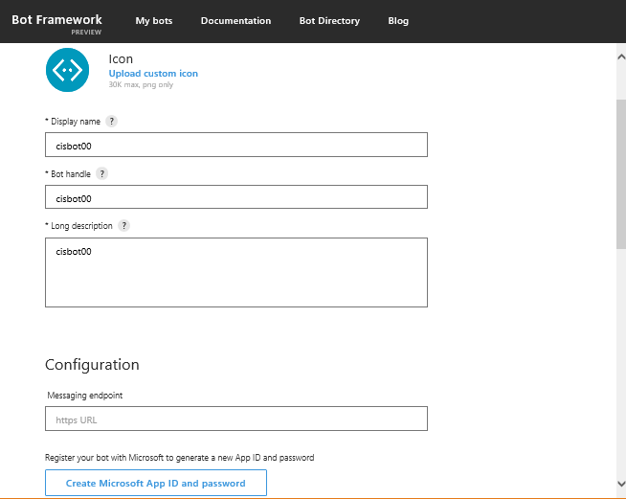
Register Your Bot (1/2)
Navigate to https://dev.botframework.com and sign in with your Azure subscription credential
Click on My bots, Create a bot, and then click Register
Enter display name and bot handle: cisbot[nn]
Provide a description
Leave Messaging endpoint empty for now.
Click on Create Microsoft App ID and password
You will need to login with a Microsoft account (not a corporate account). If you don’t have one, you can create a personal one at that step.
Once logged in, click on Generate an app password to continue button

Slide 62
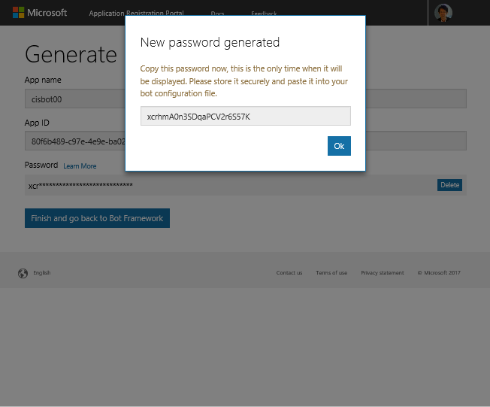
Register Your Bot (2/2)
In the new window, click on Generate an app password to continue
Copy the password and save it somewhere. You’ll need it later.
Click OK
Save App name and App ID somewhere. You’ll need them later.
Click Finish and go back to Bot Framework
Back on the Bot Profile page, scroll down and agree to the Terms of Use
Click Register

Slide 63
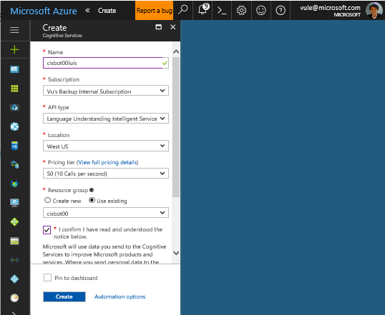
Create Language Understanding Service
Create LUIS Cognitive Service used by Bot Service
On Azure Portal, go to New → Data + Analytics → Cognitive Services
Enter a name (cisbot[nn]luis)
Select API type: Language Understanding Intelligent Service
Select Pricing tier (S0)
Select your existing resource group
Agree to the terms & condition
Click Create
Navigate to your newly created LUIS account. Then click on Keys. Copy KEY 1. You’ll need it for next step.

Slide 64
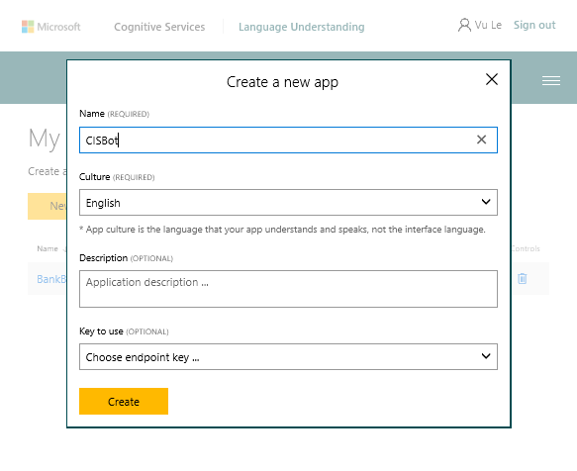
Set up Language Understanding (1/5)
Create LUIS language model
Bring up another browser tab and navigate to https://luis.ai/. Sign in with your Azure subscription credentials if required.
On the luis.ai website menu, click on My Apps then click on New App
Enter Application name - CISBot
Leave everything else blank for now.
Click Create

Slide 65
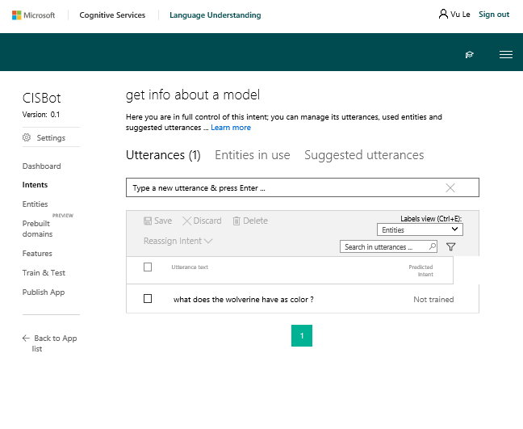
Set up Language Understanding (2/5)
Create LUIS intents
Click on Intents > Add Intent links to create a new intent.
For intent name, enter “complain about a model”
Click Save
For utterance, enter “I think the Sable has an ugly design”. Press Enter key
Click Save
Now create yet another intent with
Name = “get info about a model”
Utterance = “What does the Wolverine have as color?”

Slide 66
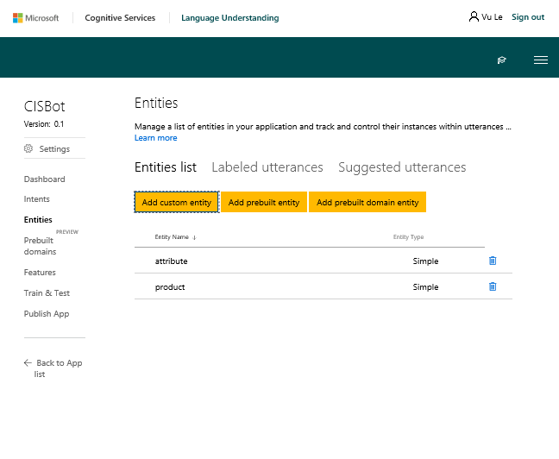
Set up Language Understanding (3/5)
Create LUIS entities
Click on Entities, then click on Add custom entity.
Enter “product”, keep entity type as Simple, and click Save.
Add a second entity called “attribute” and click Save.

Slide 67
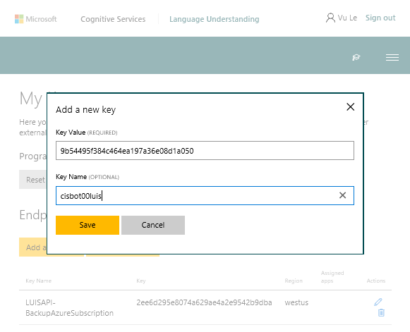
Set up Language Understanding (1/5)
Connect previously created LUIS account with LUIS language model. This key we set up will be used for publishing later.
On the luis.ai website menu, click on My Keys then click on Add a new key
Paste the LUIS account key you copied earlier into the Key Value texbox
Enter a Key Name (cisbot[nn]luis)
Click Save

Slide 68
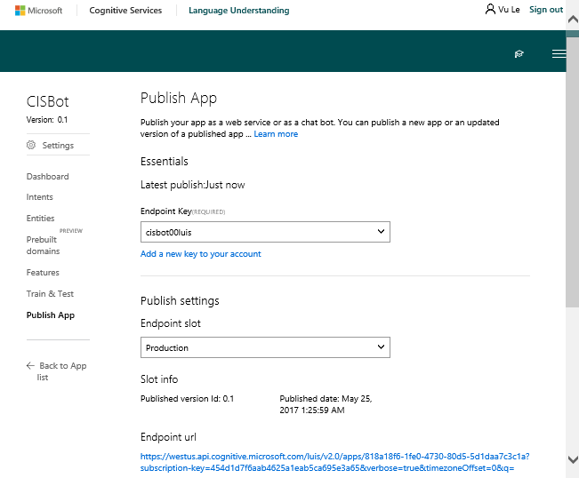
Set up Language Understanding (5/5)
Train, Test, and Publish LUIS language model.
On the luis.ai website, navigate back to your model > My Apps > CISBot
Click on Train & Test
Click on Train Application
Click on Publish App
Click on the Endpoint Key dropdown and select the key you created earlier (cisbot[nn]luis)
Scroll down a bit and click on Publish
Once the app is published, the Endpoint url will be shown. Copy the LUIS App ID and API Key and save it somewhere. You’ll need them later. The red box contains the App ID and black box contains the API Key.

Slide 69
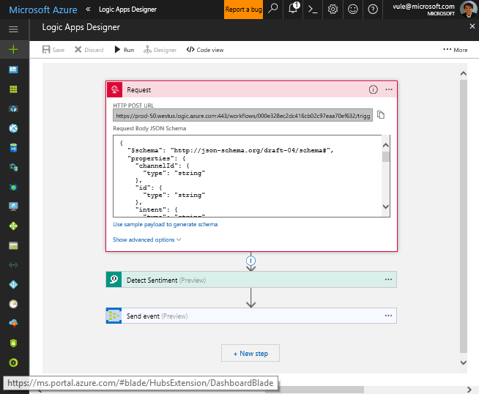
Get Your Logic App Post URL
Bring up a browser tab and go to Auzre Portal.
Navigate to your Logic App
Click Edit
Copy the HTTP POST URL to the clipboard and save it somewhere. We’ll use it in the next step.

Slide 70
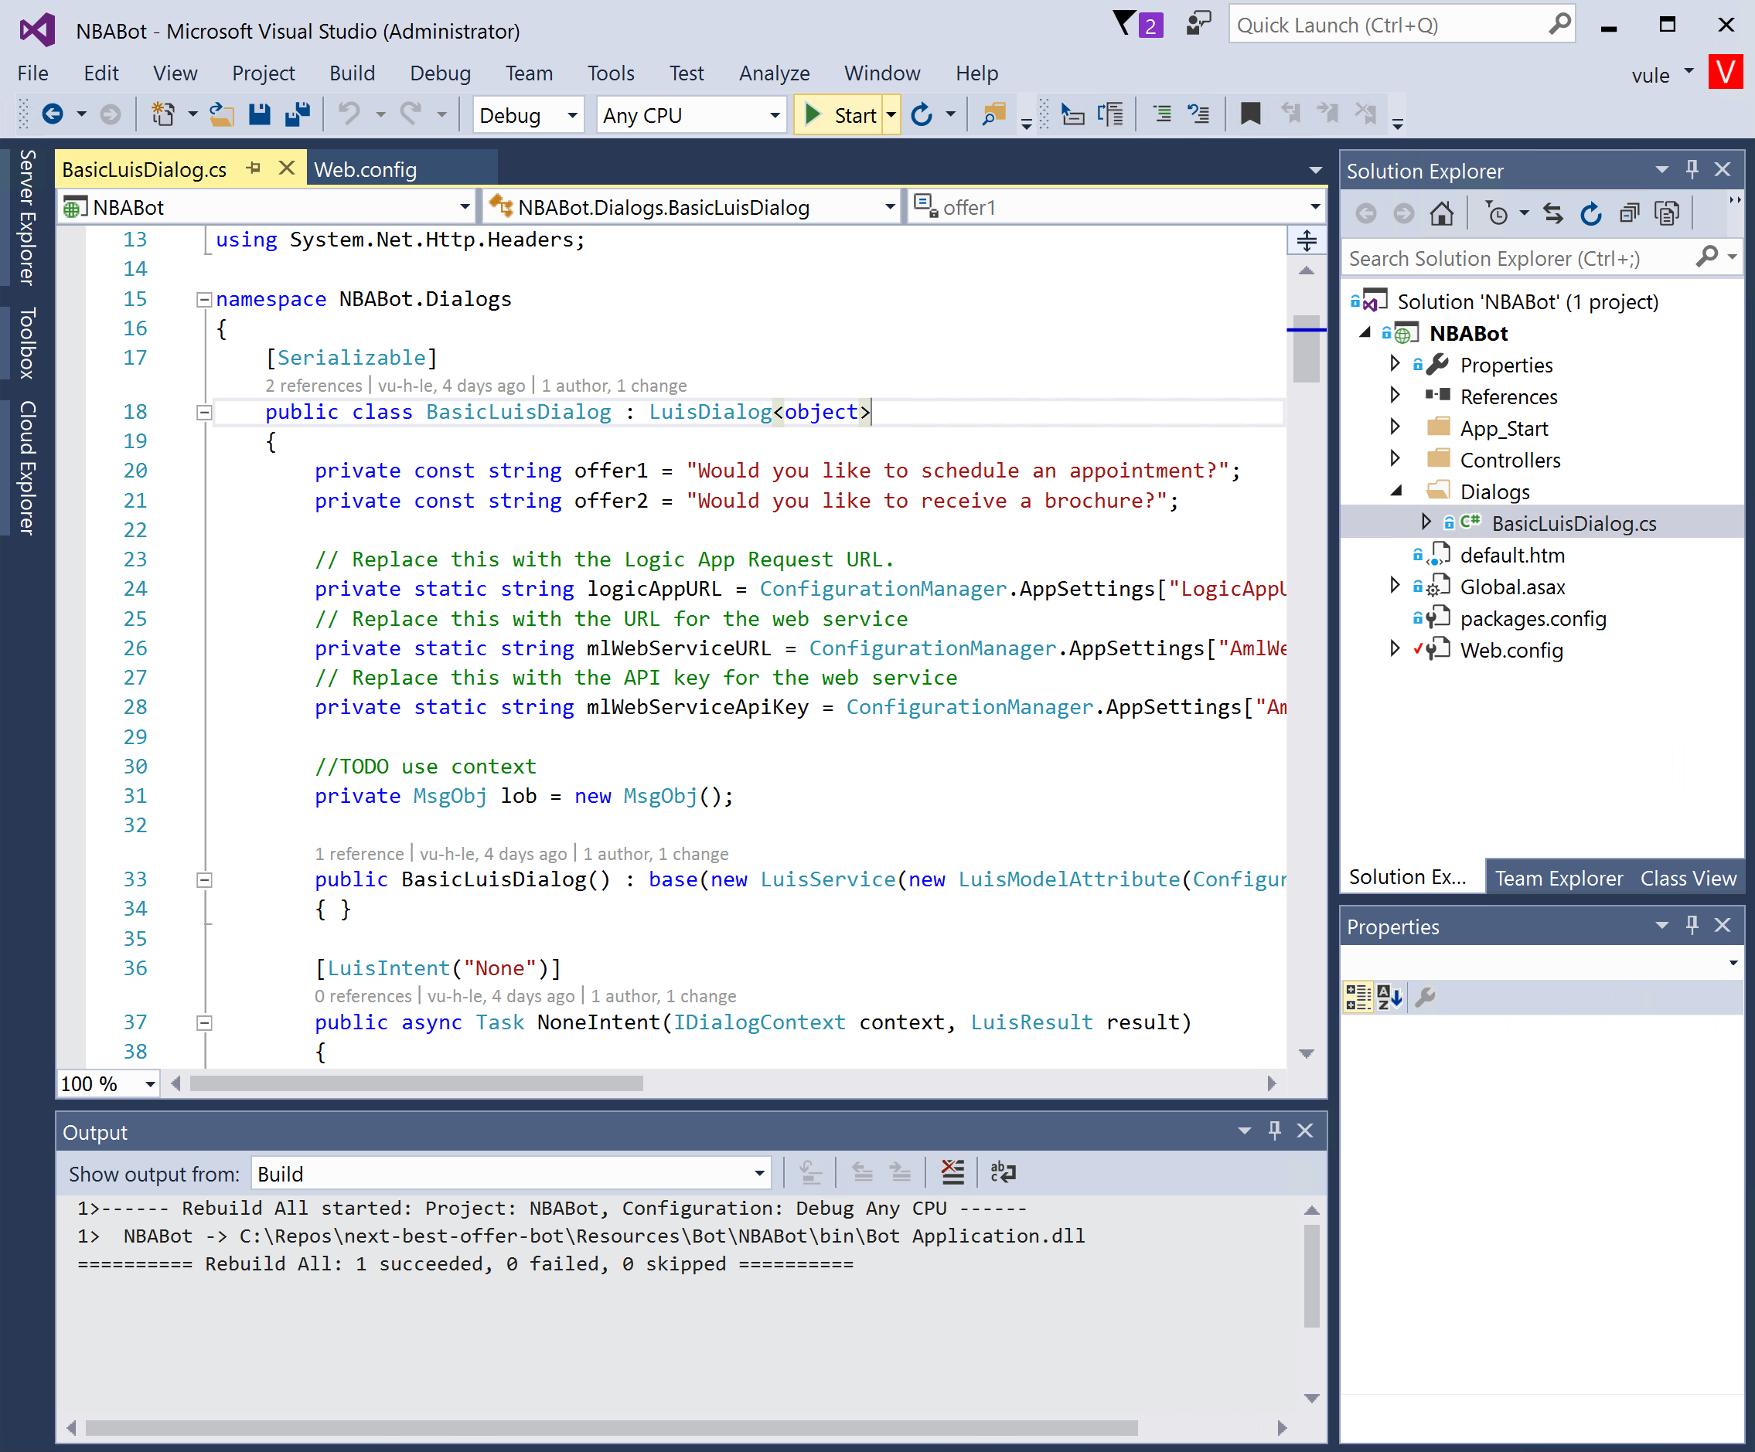
Open Visual Studio Solution
In your VM, bring up File Explorer and navigate to C:\Repos\next-best-offer-bot\Resources\Bot
Double-click on the NBABot.sln file to open in Visual Studio 2015
This solution contains code for your bot. The logic is really simple and is all contained in the BasicLuisDialog class.
All we need to do now is provide the appropriate App Setting values.
Note that the intent names match the attributes of the callback methods in the Bot code.

Slide 71
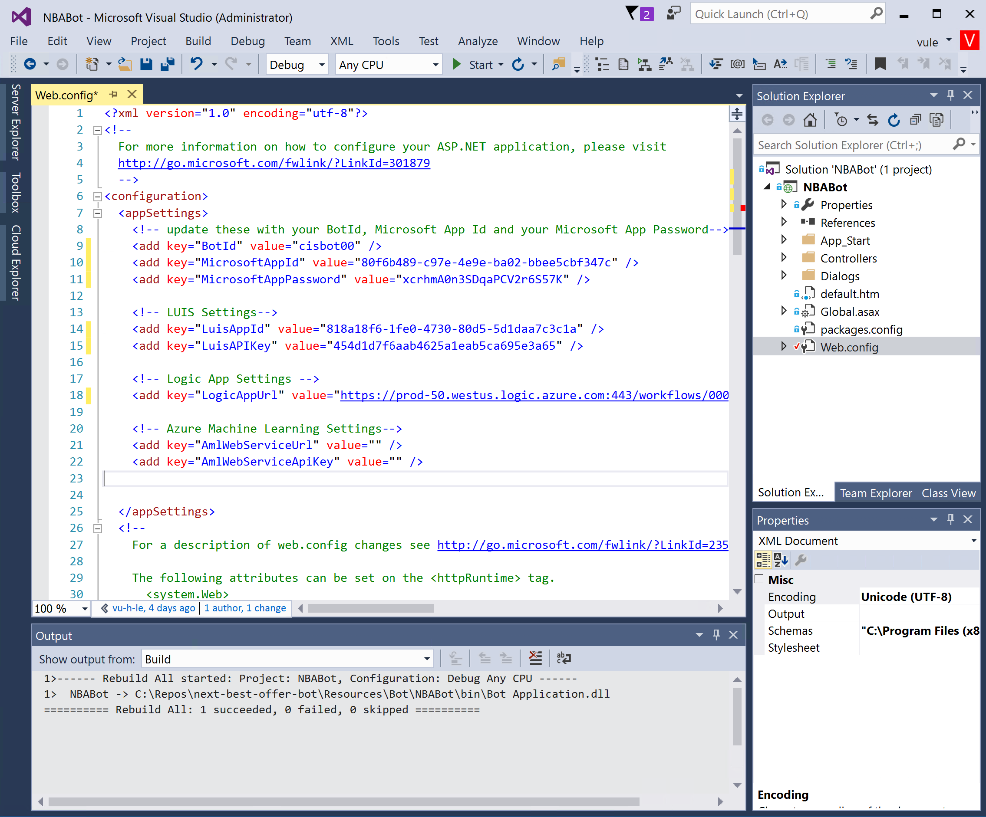
Connect Your Bot to Azure Services
In the Solution Explorer, double-click on Web.config
Provide the following App Settings with the values/keys you’ve collected in the previous few steps:
From Bot registration > dev.botframework.com > My bots > cisbot[nn] > SETTINGS
BotId – Same as bot handle
MicrosoftAppId
MicrosoftAppPassword -
From LUIS configuration > luis.ai > Publish App
LuisAppId
LuisAPIKey
Logic App > from previous step
LogicAppUrl – NOTE: you’ll need to replace all “&” in the Logic App URL with “&amp;”
We can leave the AmlWebService* settings empty for now.
Click on Start in the Visual Studio ribbon to run the code.

Slide 72

Test Your Bot (1/2)
Install and run the Bot Framework Emulator
In File Explorer, go to C:\Repos\next-best-offer-bot\Resources\Bot
Run botframework-emulator-Setup-3.5.29.exe. It will take a few minutes to install. The emulator will automatically start after installation.
Click on Enter your endpoint URL and then enter http://localhost:4000/api/messages
Provide the values for MicrosoftAppId and MicrosoftAppPassword from your Web.config file.
Click CONNECT

Slide 73

Test Your Bot (2/2)
Try interacting with the bot using the emulator. You’ll notice that it’s not that great at figuring out your intents yet. We will train LUIS to be smarter in subsequent steps.

Slide 74

Deploy Your Bot (1/3)
Back in Visual Studio, stop debugging session.
In Solution Explorer, right-click on the project name (NBABot) and select Publish…
Click on Microsoft Azure App Service

Slide 75

Deploy Your Bot (2/3)
In the new popup window, select your Azure Subscription
Click on New…
Provide API App Name – cisbot[nn]apiapp
Select your existing resource group (cisbot[nn])
If you don’t have an existing App Service Plan, click on New… to create a new one.
Click Create
Back in the Publish window, click Publish
After a few seconds, you should see the Publish Succeeded message in Visual Studio Output window. Copy the Web App URL in the Output window. You’ll need it for the next step.

Slide 76

Deploy Your Bot (3/3)
In a web browser, navigate to your bot registration at dev.botframework.com
Click on My bots and choose your bot.
Click on SETTINGS tab
Under Messaging endpoint, enter your web app URL plus this text “/api/messages”. Make sure you use https protocol.
Scroll to the bottom an click Save changes

Slide 77

Simulate interactions with your Bot (1/4)
The lab contains a PowerShell script that simulates a few hundred human interactions with the bot. To communicate with the bot, the script requires a Web Chat channel access key.
Navigate to dev.botframework.com and select your bot.
Click the CHANNELS tab
Click Edit for the Web Chat channel

Slide 78

Simulate interactions with your Bot (2/4)
Click +Add new site
Enter a name your site (Simulator)
Click Done

Slide 79

Simulate interactions with your Bot (3/4)
Under the first Secret key, click Show and copy the key to the clipboard
Click Done

Slide 80

Simulate interactions with your Bot (4/4)
Run Windows PowerShell as administrator
In PowerShell, change to C:\Repos\next-best-offer-bot\Scripts folder.
Run the script 220-run-simulator.ps1.
When prompted for the Bot Webchat secret, paste the key from the previous step.
Let the simulator run for a few minutes. Then continue to the next steps, leaving the simulator running in the background. You might see Bad Gateway errors. It’s OK to ignore them.
Good time for a break.

Slide 81

Train Language Understanding Module (1/3)
Use Active Learning to improve LUIS model.
Return to your LUIS application (https://luis.ai)
Click Intents, choose any intents, then Suggested utterances. Utterances from the simulator will appear. (It may take a few minutes before they appear.)

Slide 82

Train Language Understanding Module (2/3)
For each utterance
Identify and assign words that are either an attribute or product entity.
Assign utterance to the correct intent: “get info about a model” or “complain about a model”
Click Save or Reassign Intent depending on what you’re changing.

Slide 83

Train Language Understanding Module (3/3)
After you’ve labeled at least a dozen utterances, click Train & Test then click on Train Application
Once the model is retrained, type a few test utterances to see the improvements. The intent, along with the probability score, is shown on the right side.
Click Publish App then Publish
Run the Simulator again (or leave it running if it’s still running in the background) to produce data to report on.

Slide 84

Create real-time dashboard (1/4)
We’re almost done with Phase 1. We now create a Power BI dashboard to display real-time sentiment from Stream Analytics.
Navigate to https://powerbi.com and log in.
Click the Settings menu on the top toolbar (cogwheel icon), then Settings
Under Preview features, make sure Early access to features is set on On.
This makes the following steps slightly easier.

Slide 85

Create real-time dashboard (2/4)
Click My Workspace
Click + Create then choose Report
In the “Select a dataset for this report” search box, type “cisbot”. You should see the cisbot dataset that was created by Stream Analytics.
Select the cisbot dataset
Click on Create

Slide 86

Create real-time dashboard (3/4)
Use the provided visualizations to generate a report looking like this screenshot
Click File → Save and save your Report under the name Bot realtime data

Slide 87


Create real-time dashboard (4/4)
For each visualization in the chart, click the Pin icon, and pin the visual to a new dashboard named CISBot. Do this for all visualizations.
Screenshot on the right is what the dashboard looks like after renaming the tiles.

Slide 88
Solution implemented at this point
LUIS
Cognitive Service
Bot
Logic App
Event Hub
Stream Analytics
Power BI
Sentiment analysis
Text Analytics Cognitive Service
Data Lake Store

Slide 89
Interlude: monitoring Azure resources
We’ve implemented the main parts of the solution by now, and the simulator is pushing messages into the bot.
Let’s look at the monitoring for the various components to find out if the messages are coming through as intended.

Slide 90

Monitor your Logic App
Navigate to your Logic App.
You should see a list of successful executions in the Runs history section.

Slide 91

Monitor your Event Hub
Navigate to your Event Hubs namespace.
In the Overview pane, in the Metrics section, you should see that incoming messages are getting through.

Slide 92

Monitor your Stream Analytics job
Navigate to your Stream Analytics job.
In the Overview pane, in the Monitoring section, you should see messages going through.

Slide 93
Phase 2: set up machine learning model
Now we prepare a training set and create a machine learning model, to allow the bot to issue the offer most likely to be accepted in each conversation.

Slide 94

Prepare ML training set (1/3) 230-generate-ml-training-data.ps1
We create a U-SQL job to process archived messages into a table containing one line for each observed interaction (pair of offer made and response received).
Navigate to your Data Lake Analytics instance.
Click Data Explorer
Browse your Data Lake Store account, to ensure the bot data is being captured into subdirectories of botdata/raw/ partitioned by year, month, day and hour.

Slide 95

Prepare ML training set (2/3) 230-generate-ml-training-data.ps1
Go to your Data Lake Analytics service
In DATA LAKE ANALYTICS, select +New Job
Provide an optional job name (Prepare ML Training Data)
Paste the script from C:\Repos\next-best-offer-bot\Resources\MachineLearning\prepare-ml-training-set.usql into the main textbox.
Replace $storageAccountName (at the top of the script) with your storage account name (cisbot[nn]storage)
Click Submit Job

Slide 96

Prepare ML training set (3/3)
After the job completes all 4 stages: Preparing, Queued, Running, Finalizing, click on the Output tab.
Check that the file interactions.csv was produced.
Click on the file name to preview its content.

Slide 97

Create AML workspace (1/2)
We create a workspace for our Azure ML experiment.
Go to New → Data + Analytics → Machine Learning Workspace
Enter a name (cisbot[nn]aml)
Select your existing resource group
Choose West Central US for Location
Under Web service plan pricing tier, select S1 Standard
Click Create

Slide 98

Create AML workspace (2/2)
Navigate to your newly created Machine Learning Workspace
Click “Launch Machine Learning Studio”
Sign in with your Azure subscription credential.
If you have more than one AML workspaces, then you’ll need to select the REGION, then select the workspace you created.

Slide 99

Create AML experiment (1/9)
Navigate to your Azure storage account (cisbot[nn]storage)
Under SETTINGS → Access keys, copy your primary key (key1)

Slide 100

Create AML experiment (2/9)
In Machine Learning Studio, Click + NEW, Blank Experiment

Slide 101

Create AML experiment (3/9)
Under Data Input and Output, drag Import Data onto the canvas.
For Account name, enter your Storage account name (cisbot[nn]storage)
For Account key, paste your storage account key from the previous step
For Path, type interaction-data/interactions.csv
Click RUN

Slide 102

Create AML experiment (4/9)
Click on the output of the Import Data step, and then on Visualize
Note that the columns have non-descriptive names. We will rename the columns in the next step.
Close the Visualize window

Slide 103

Create AML experiment (5/9)
Under Data Transformation → Manipulation, drag Edit Metadata onto the canvas and connect it to the previous step.
Click Launch column selector and select all columns
Under new column names, enter intent, product, offer, outcome
Click RUN

Slide 104

Create AML experiment (6/9)
Under Data Transformation → Sample and Split, drag Split Data onto the canvas and connect it to the previous step.
Under Fraction of rows in the first…, type 0.8
Under Machine Learning → Initialize Model → Classification, drag Two-Class Decision Forest onto the canvas

Slide 105

Create AML experiment (7/9)
Under Machine Learning → Train, drag Train Model onto the canvas
Connect it to the first data split and to the Decision Forest model
Click Launch column selector
Click on the column name text box and choose outcome
Click OK

Slide 106

Create AML experiment (8/9)
Under Machine Learning → Score, drag Score Model onto the canvas
Connect it to the second Split Data output and to the trained model
Under Machine Learning → Evaluate, drag Evaluate Model onto the canvas
Connect it to the scored model
Click Run

Slide 107

Create AML experiment (9/9)
Click on the output of the Evaluate Model step, and then on Visualize
Note the accuracy of the model is 0.609. Your figure will be slightly different because of randomness in the simulator.
In the simplest interpretation, if 50% of customers would want each of the two offers, machine learning allows us to predict the correct offer for 60.9% of customers, up from 50% with a ‘coin toss’ or by making the same offer to all customers.
Close the Evaluation results dialog.

Slide 108

Deploy AML web service
We deploy a web service to allow the bot running our trained model on new interactions, and issue the offer predicted to be the most likely to be accepted.
Click Set up Web Service → Predictive Web Service
Change the connection from Web service input to go to Score Model, rather than Edit Metadata. Delete and reconnect…
Click RUN
Click DEPLOY WEB SERVICE > Deploy Web Service New
Choose Price Plan (cisbot00amlPlan) created along with the AML workspace
Click Deploy

Slide 109
Phase 3: integrate bot with machine learning
We will set up the bot to use the ML model to issue the offer predicted to be most likely to be accepted by the customer, rather than a random offer.

Slide 110

Integrate Azure ML web service with your Bot (1/5)
After AML web service has deployed, click on the Consume tab

Slide 111

Integrate Azure ML web service with your Bot (2/5)
Copy the Primary Key and Request-Response URI. Save it somewhere. You’ll need it for the next step.

Slide 112

Integrate Azure ML web service with your Bot (3/5)
Provide the AML web service URL and API key
Return to Visual Studio Solution.
Open Web.config file and paste in the values for AmlWebServiceUrl and AmlWebServiceApiKey. Remember to replace “&” with “&amp;” in the AmlWebServiceUrl setting value.
Click Save

Slide 113

Integrate Azure ML web service with your Bot (4/5)
Update bot code to call AML web service instead of making random offers.
In Visual Studio Solution Explorer, open Dialogs/BasicLuisDialog.cs
Go to line 84 and comment out the random offer.
Uncomment line 85, where it’s calling GetOptimalOfferFromMLService method.
Rebuild Solution

Slide 114

Integrate Azure ML web service with your Bot (5/5)
Publish your changes to Azure API App.
Right-click on project name and choose Publish…
Click Publish again to publish the code changes to your cisbot[nn]apiapp
Test your new code changes either in Skype or with Bot Framework Emulator.

Slide 115
Phase 4: cold path processing & analytics dashboard
We will use U-SQL to extract topics from messages. This transforms unstructured data to structured data that can be stored in a data warehouse for reporting and analytics.
Data transformation and loading processes are most effectively run in batch mode (‘cold path processing’), as long as the data does not need to be updated in near-real-time in the front-end.

Slide 116

Create SQL DW (1/4) 310-create-data-warehouse.ps1
Create a Data Warehouse to store structured data extracted from messages.
Go to New → Databases → SQL Data Warehouse
Enter a name (cisbot[00]dw)
Select your existing resource group (cisbot[nn])
Under Server, select Create a new server
Enter a unique name (cisbot[00]sqlsvr)
Select a login and password
Avoid using equals “=“ or semicolon “;” in password
Make sure you remember login and password
Leave location at West US
Click Select

Slide 117

Create SQL DW(2/4) 310-create-data-warehouse.ps1
Under Performance, select 100
Click Create
Wait for deployment to complete successfully.

Slide 118


Create SQL DW (3/4) 310-create-data-warehouse.ps1
In Visual Studio, Open the SQL Server Object Explorer, under the View menu
Right click SQL Server → Add SQL Server
In the dialog, connect to your Azure subscription if necessary
Select your newly created SQL DW
Enter your password
Click Connect
If a dialog “Create a firewall rule” appears, click OK

Slide 119

Create SQL DW (4/4) 310-create-data-warehouse.ps1
Right-click your SQL Server instance in the SQL Server Object Explorer View
Click New Query…
Select your SQL DW database (cisbot[nn]dw) in the drop-down menu
Paste the following DDL query in the editor
Press Execute
CREATE TABLE [dbo].[BotDetailedData] (
[timestamp] datetime2(7),
[intent] nvarchar(100),
[channelId] nvarchar(100),
[id] nvarchar(100) NOT NULL,
[product] nvarchar(250),
[score] decimal(19, 10),
[text] nvarchar(4000),
[EventProcessedUtcTime] datetime2(7),
[PartitionId] bigint,
[EventEnqueuedUtcTime] datetime2(7),
[KeyPhrase] nvarchar(4000)
)
WITH (CLUSTERED COLUMNSTORE INDEX, DISTRIBUTION = HASH([id]));

Slide 120

Create Data Factory (1/9) 320-create-data-factory.ps1
Create a Data Factory pipeline to orchestrate data movement and transformation (using U-SQL jobs).
Go to New, search for “Data Factory”, click Data Factory, Create
Enter a name (cisbot[nn]adf)
Select your existing resource group
Select a location. Note that the region does not need to match the region where your data is located but for this lab, choose West US
Click Create

Slide 121

Create Data Factory (2/9)
In Visual Studio
Go to File → New → Project
Select Data Factory → Empty Data Factory Project
Select a name and location for your solution files
Click OK

Slide 122

Create Data Factory (3/9)
In the Solution Explorer view, right-click on your project, then Add → Existing Item…
Navigate to C:\Repos\next-best-offer-bot\Resources\DataFactory\Pipelines directory
Select all files in this directory
Click Add

Slide 123

Create Data Factory (4/9)
In the Solution Explorer view, right-click on your data factory project, then Add → New Item…
Perform this operation 4 times to create the resources as specified in the table below. Make sure you name the resources exactly as indicated.
Follow the wizard in creating these resources. Accept the defaults and sign-in if required.
Type | Name
Azure Data Lake Analytics Linked Service | DataLakeAnalyticsLinkedService.json
Azure Data Lake Store Linked Service | DataLakeStoreLinkedService.json
Azure SQL Data Warehouse Linked Service | SqlDwLinkedService.json
Azure Storage Linked Service | BlobLinkedService.json

Slide 124


Create Data Factory (5/9)
Double-click on the SqlDwLinkedService.json and update the connectionString with the appropriate values for:
<servername> - cisbot[nn]sqlsvr
<databasename> - cisbot[nn]dw
<password> - your password
Double-click on BlobLinkedService.json and update the connectionString with appropriate values for:
<accountname> - cisbot[nn]storage
<accountkey>- storage account key
Save All files
Note: In production environments, use Azure Key Vault to store sensitive information instead.

Slide 125


Create Data Factory (6/9)
From the Solution Explorer view, open the file ProcessBotTextPipeline.json
Change the placeholder $startDate in the file with yesterday’s date in ISO 8601 format (2017-01-20). This will allow the pipeline to run immediately over the data collected yesterday. (If you enter today’s date, the pipeline will only run the next night at midnight).
Save the file.

Slide 126
Create Data Factory (7/9)
Note that the scheduler is set to start activities at the StartOfInterval. That means the Data Factory will process the data for a given day at the beginning of the day. This is for the purpose of this workshop, so that the slice for today starts immediately.
If you want the pipeline to process daily data in the future, change style to EndOfInterval in the Pipeline and all Dataset definitions, and publish the pipeline again.

Slide 127

Create Data Factory (8/9)
In the Solution Explorer view, right-click on your project, then Publish…
Select existing Data Factory (cisbot[nn]adf)
Click Next multiple times until the wizard completes, then Finish.
In the current state of this lab, Linked Services for Data Lake Analytics & Store will return errors during deployment. Proceed to next slide for workaround.

Slide 128

Create Data Factory (9/9)
In Azure Portal, navigate to your Data Factory
Click on Author and deploy
Expand Linked services and select the linked service with the red exclamation next to it.
Click on the Authorize button and follow the sign-in process.
Once signed in, the JSON on the right side will update with the latest authorization tokens. Copy this entire JSON and paste it to the DataLakeAnalyticsLinkedService.json file.
In Visual Studio, Publish again.
Repeat these steps for the DataLakeStoreLinkedService.

Slide 129

Monitor Data Factory (1/2)
Go to your Data Factory
Click Monitor and Manage

Slide 130

Monitor Data Factory (2/2)
Check the ACTIVITY WINDOWS for the two activities in the pipeline
It may take a few minutes for the activities to light up
Check that the activities have executed successfully

Slide 131

Create historical report (1/5)
We create a report presenting data from the SQL Data Warehouse.
Navigate to your SQL Data Warehouse
Click Open In PowerBI
Sign into your PowerBI account if required.

Slide 132

Create historical report (2/5)
Click Next
Enter your database password and click Sign in

Slide 133

Create historical report (3/5)
Click My Workspace, then Datasets
A new dataset named after your SQL DW (cistbot[nn]dw) is listed. It might take a few minutes to appear.
Click on the “Create report” icon next to it. It’s the chart icon.

Slide 134



Create historical report (4/5)
Use the Funnel visualization to create a visual like the one shown.

Slide 135




Create historical report (5/5)
Create a few more visuals such as the one shown.
Hint: use filters to exclude irrelevant content.
Click File → Save and save your Report under the name “Bot historical data”
Click the Pin icon on one of the charts, and pin the visual to the Existing dashboard (CISBot)

Slide 136

View dashboard combined reports
As we have pinned items from both the real-time and historical reports to the same dashboard, we can use the dashboard to view those data together and jump to the detailed reports.
Click My Workspace, then click on the “CISBot” dashboard
Interact with your dashboard

Slide 137




Set up alerting (1/4)
We set up a near-real-time alert in case sentiment decreases below a certain threshold.
Run the simulator again to make sure there is data for the last 10 minutes
In the box “Ask a question about your data”, type: average of score over last 10 minutes as gauge
Change the Title of the visual to Sentiment score over last 10 minutes
Click Pin visual, add the visual to the existing dashboard (CISBot)

Slide 138


Set up alerting (2/4)
Do you remember from the case story that Mark wanted to be alerted in near-real-time when the sentiment dropped below a certain threshold?
We will use the Data alerts functionality. It is only available on the iPhone and Windows 10 mobile apps, and the Power BI Service. We will show the iPhone app in this guide.
Install the Power BI app on your device and interact with your dashboard

Slide 139

Set up alerting (3/4)
Click on the visual “Sentiment score over last 10 minutes”. Then click on the Alerts icon (bell).

Slide 140

Set up alerting (4/4)
Set up an alert with the value is below a threshold. Set a high threshold value (e.g. 0.9) so that we can test that the alert is triggered.
Click Save
It may take about an hour for the alert to be emitted.

Slide 141
Congratulations!
You’ve completed a very complex and demanding lab!

Slide 142
Machine learning everywhere!
Do you realize we’ve used machine learning in three places in this lab?

Slide 143
Machine learning everywhere!
That’s right:
LUIS uses Artificial Intelligence to match utterances by similarity to the ones that we manually labeled
We built our own scoring machine learning model in Azure ML
We used the Power BI natural language Q&A feature

Slide 144
Clean-up
Let’s delete the resources from our Azure subscription

Slide 145

Pause SQL Data Warehouse
You may want to leave the lab running for some time to share it with your friends and colleagues. If you do, make sure you Pause the SQL Data Warehouse as it will otherwise consume significant credit. Other components only incur a small cost.
Go to your SQL DW and click Pause.

Slide 146

Delete Resource Group
When you’re done, go to the Resource groups pane and click “…” next to your resource group. Then click Delete, and follow the steps in the confirmation dialog.
WARNING: this will delete all the work you’ve performed in this lab!

Slide 147

© 2017 Microsoft Corporation. All rights reserved. Microsoft, Windows, Windows Vista and other product names are or may be registered trademarks and/or trademarks in the U.S. and/or other countries.
The information herein is for informational purposes only and represents the current view of Microsoft Corporation as of the date of this presentation. Because Microsoft must respond to changing market conditions, it should not be interpreted to be a commitment on the part of Microsoft, and Microsoft cannot guarantee the accuracy of any information provided after the date of this presentation. MICROSOFT MAKES NO WARRANTIES, EXPRESS, IMPLIED OR STATUTORY, AS TO THE INFORMATION IN THIS PRESENTATION.

